Slide 1
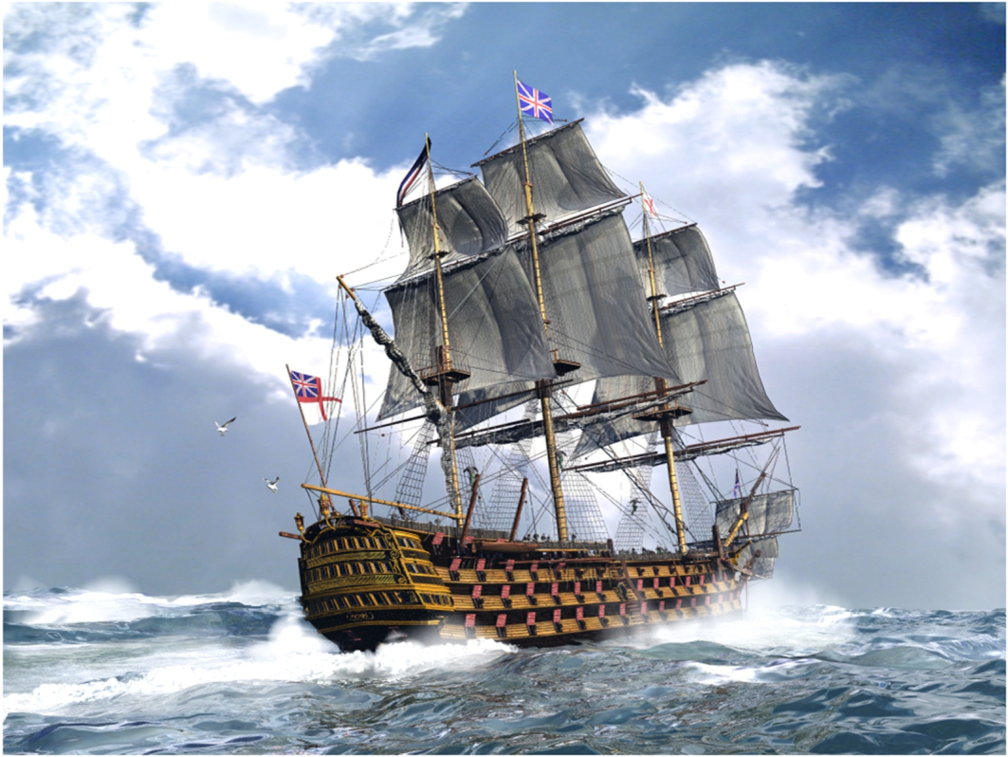
Great Geographical Discoveries of Britain
Created by Sidorkov N. 10 “A”
Lyashenko Kirill

Slide 2
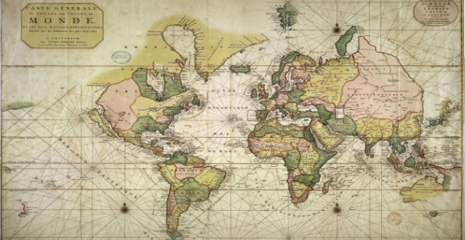
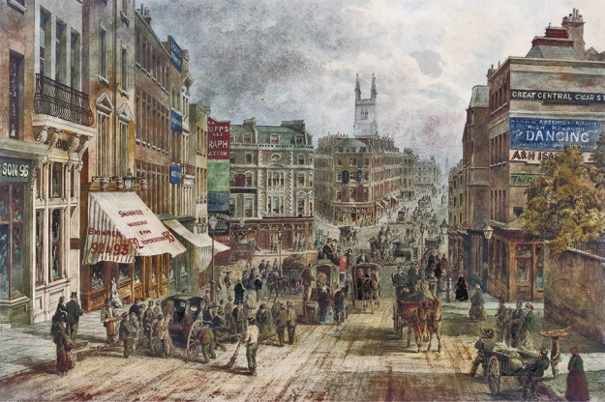
Purpose of study:
Tell about great world discoveries of Britain.
Investigate the influence of great world discoveries on culture of Britain.
3) conclusion + booklet

Slide 3
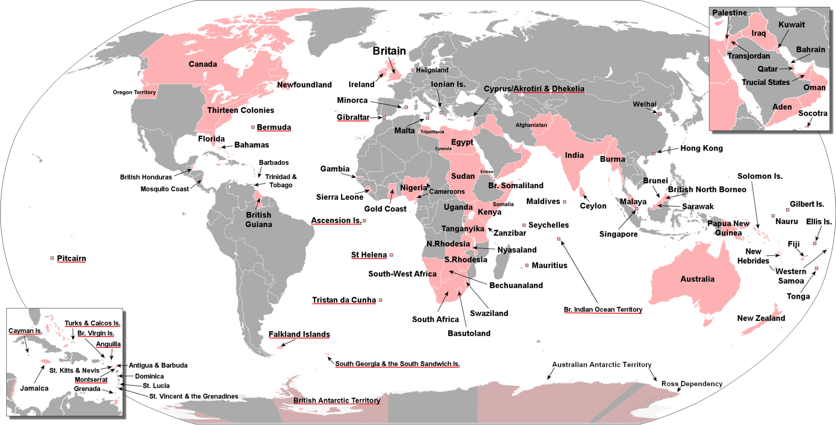
The biggest colonies of UK: Canada, India and Pakistan, Sudan, Egypt, South Africa, Australia,
New Zealand, Kenya, Afghanistan and Thirteen Colonies.

Slide 4
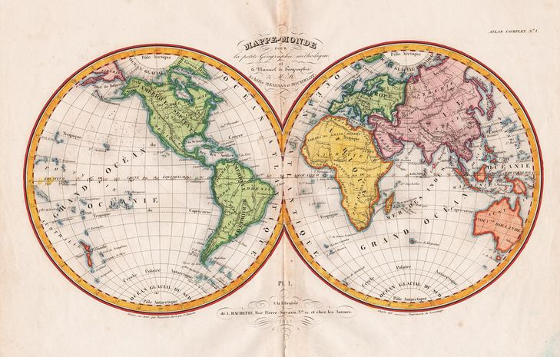
1)Great World Discoveries of Britain

Slide 5
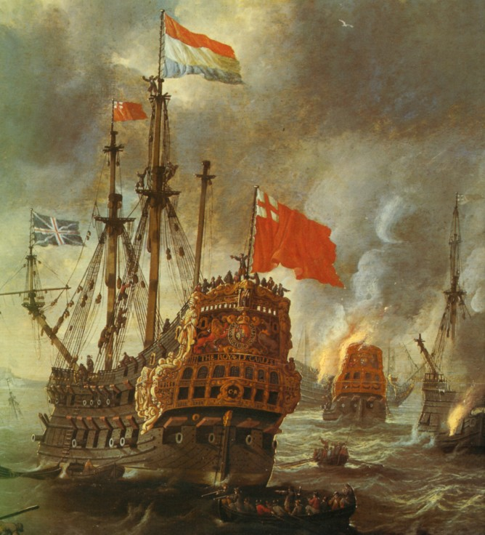
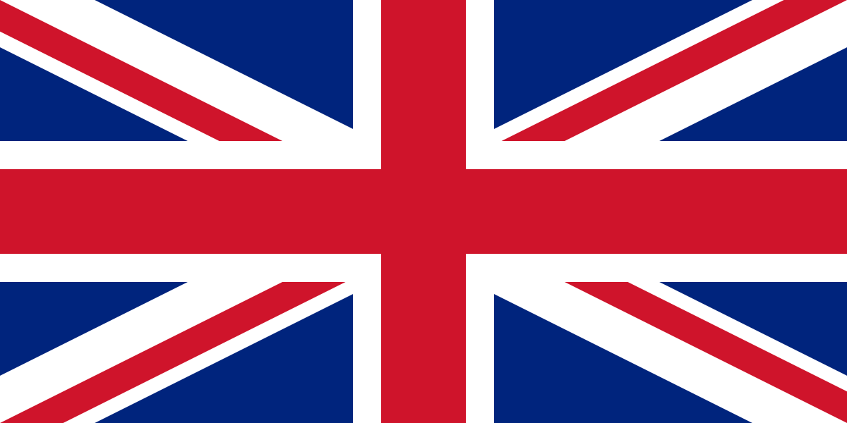
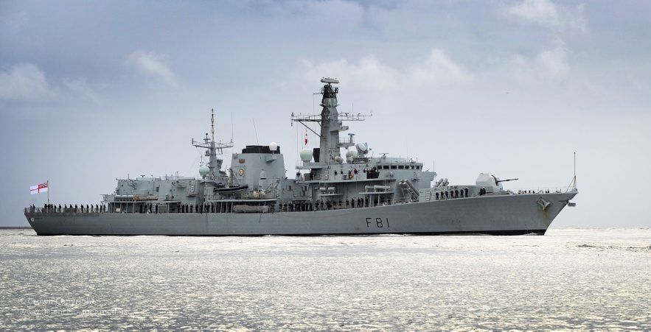

Slide 6
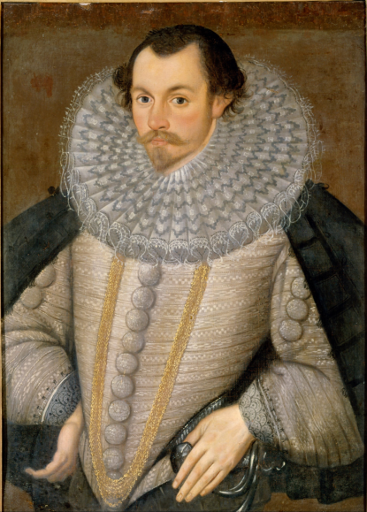
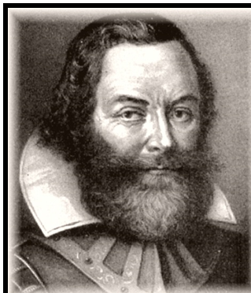
May 30, 1578 - August 31, 1578
Martin Frobisher
In the last quarter of the 16th and early 17th centuries, the British sailors made a series of voyages, hoping to find the Northwest Passage from the Atlantic Ocean to the Pacific. The first 80 years after the father and son of Cabot, the search for this passage was resumed by the naval officer Martin Frobisher.
1583
John Davis
The search for the Northwest Passage was continued by John Davis. June 7, 1585 vessels sailed from Dartmouth, and in the second half of July reached the southeastern edge of Greenland, along the coast. From here the ships turned to the northwest, crossed the Davis Strait and reached the Exeter Cove near the Cumberland Peninsula (Baffin Island). Deciding that this is the Northwest Passage, John Davis returned to England on September 30, 1585 with this news.

Slide 7
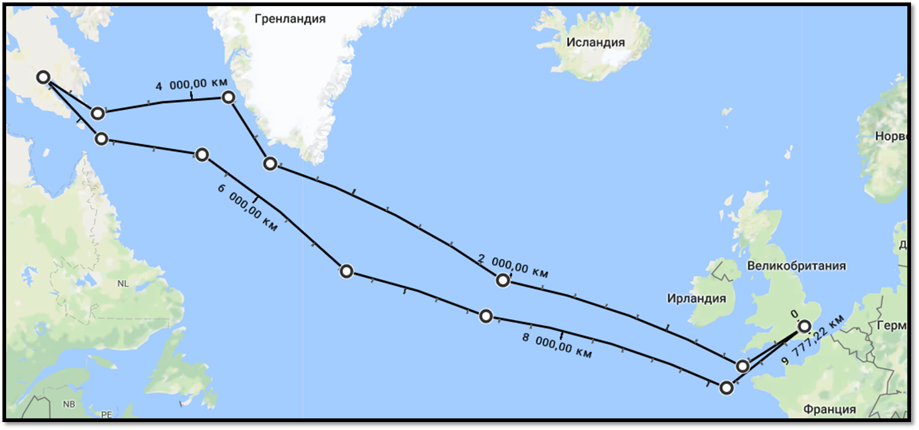
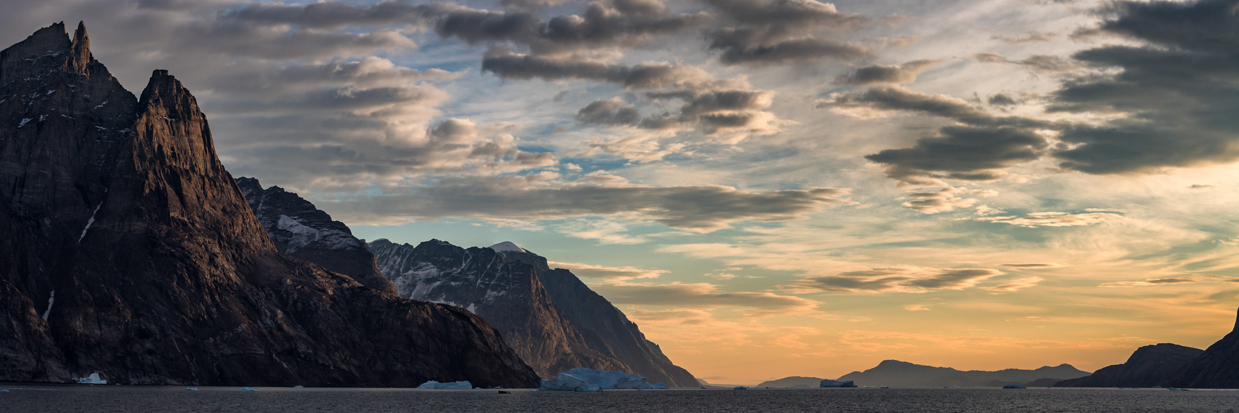
1578

Slide 8
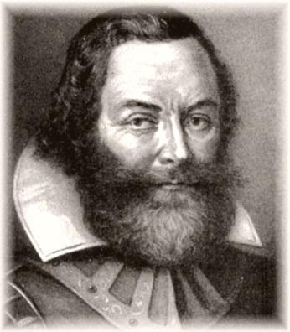
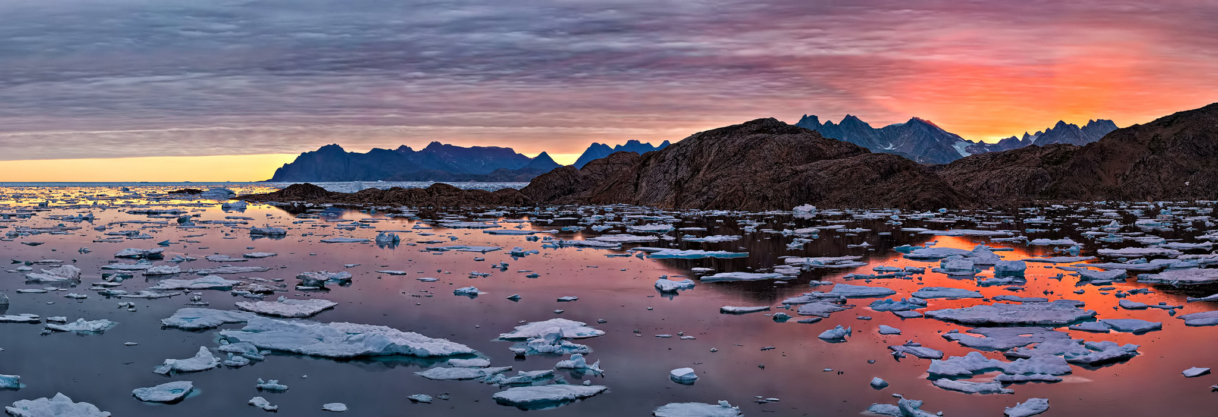
1583

Slide 9
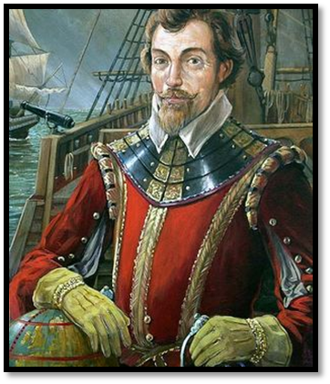
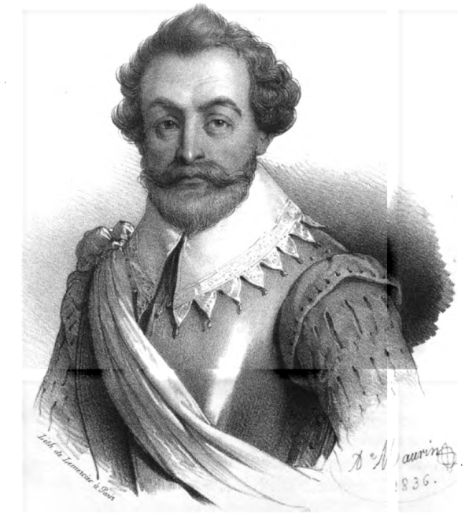
1577—1580
Another English traveler, mostly a pirate, whose main merit is that he was the first among the English and the second after Magellan made a round-the-world voyage, though not planned in advance, was Francis Drake.
In 1577 he proceeded to the most important of his enterprises. The aim of the pirate was a raid on the Pacific coast of Spanish America. On December 13, 1577, the flotilla left Plymouth. In April 1578, Drake reached the mouth of La Plata, and on August 21 entered the Strait of Magellan, at the exit of which the flotilla was caught by a storm lasting 52 days. After the storm, only one ship remained (the Golden Hind), which was thrown back by the storm south almost five degrees from the exit from the Straits of Magellan, as a result, Drake was able to make sure that beyond the Tierra del Fuego stretches the open sea, named after the discovery of Antarctica by the Drake Passage.

Slide 10
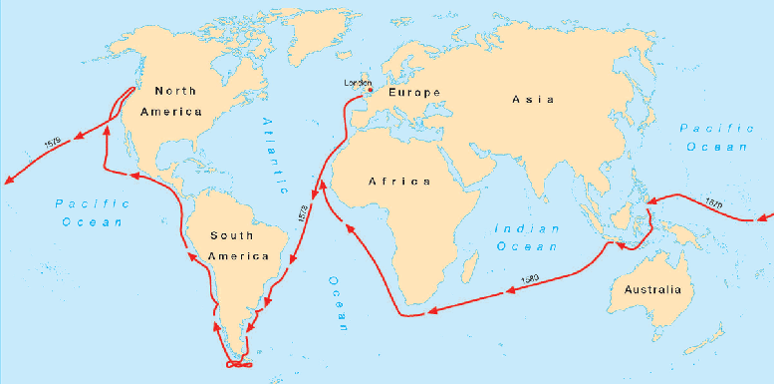
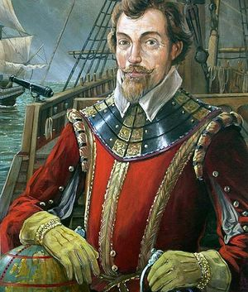
1577—1580
Francis Drake

Slide 11
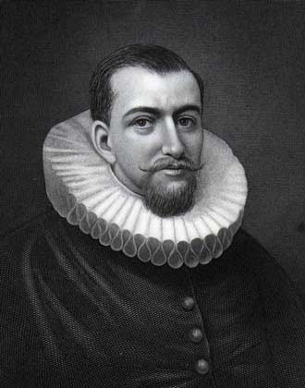
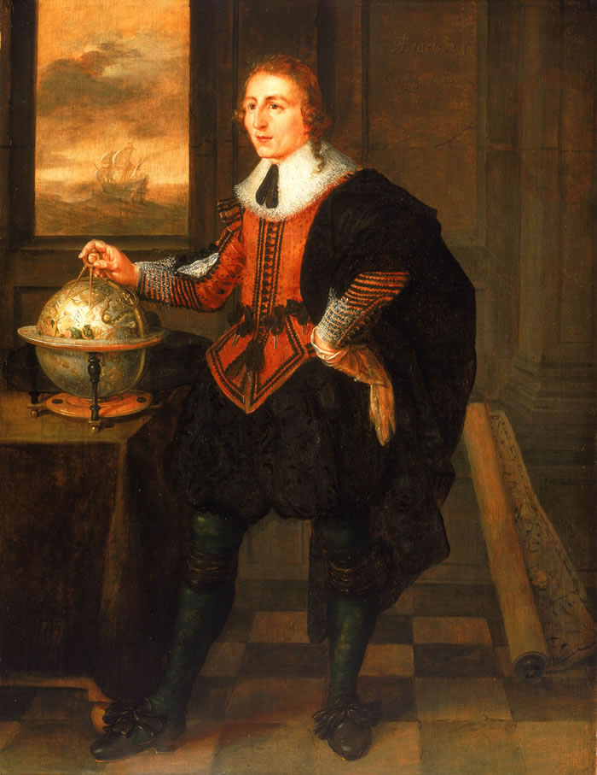
1607
Henry Hudson
Another English traveler who tried to reach India northwest way was Henry Hudson.
His first voyage took place in 1607. Moving along the eastern coast of Greenland, he reached the islands of Spitsbergen, and rounded them from the north. Returning to London in mid-September, he spoke about the possibilities of whaling in the Far North and this contributed to the development of English whaling in the Spitsbergen area.
1612, 1615
William Baffin
In the years 1615-1616. along with R. Baylot on the ship "Discovery" explored the Hudson and Baffin Bay to the Smith Strait, as well as the sea west of Greenland, named after Baffin. A series of straits, radially diverging from the bay of his name, Baffin named the organizers of the expeditions - Lancaster, Smith and Sound. During the expedition, the islands of Hayes (Greenland), Ellesmere, Devon and others were discovered in the Canadian Arctic archipelago. Passing 300 miles farther to the west than his predecessor John Davis, Baffin did not find the Northwest Passage and decided that he did not exist at all.

Slide 12
1607

Slide 13
1612, 1615

Slide 14
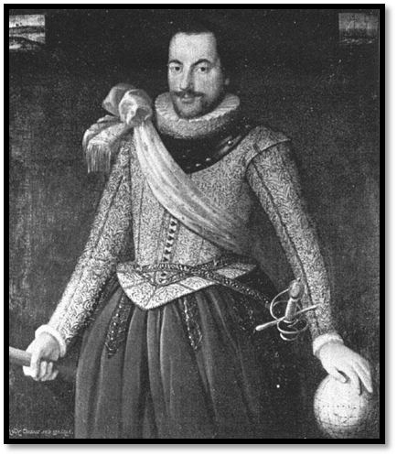
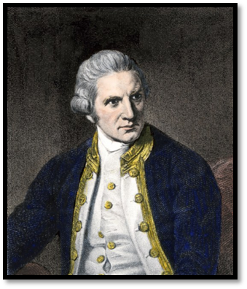
May 1631
Thomas James and Luke Fox
In 1631, the British again engaged in the search for the Northwest Passage from the Hudson Bay. Under the command of Thomas James and Luke Fox were equipped with two ships by different companies. Both vessels left almost at the same time (in the first days of May 1631), but each commander in itself. Later the bay between Baffin Land and the mainland into which Fox penetrated was called the Fox Basin, and the southern strait connecting it to the Hudson Bay is the Fox Strait.
1768—1771
James Cook
In 1766, the Admiralty is engaged in cooking a scientific voyage to the Pacific Ocean. James Cook, at the age of 39, was promoted to lieutenant to grant. The expedition sailed aboard HMS Endeavor, departing England on 26 August 1768. Cook and his crew rounded Cape Horn and continued westward across the Pacific to arrive at Tahiti on 13 April 1769, where the observations of the Venus Transit were made. However, the result of the observations was not as conclusive or accurate as had been hoped. Once the observations were completed, Terra Australis.

Slide 15
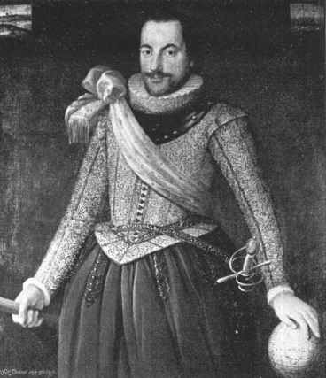
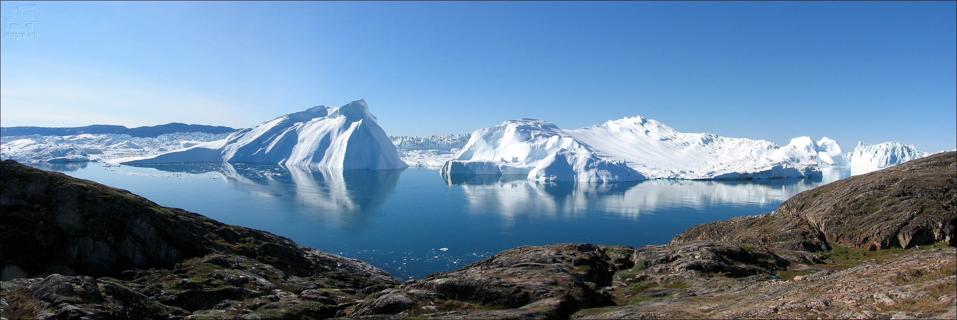
May 1631

Slide 16
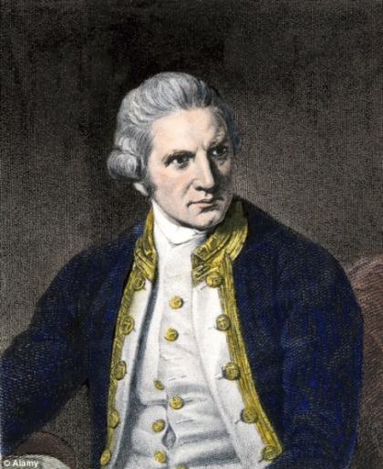
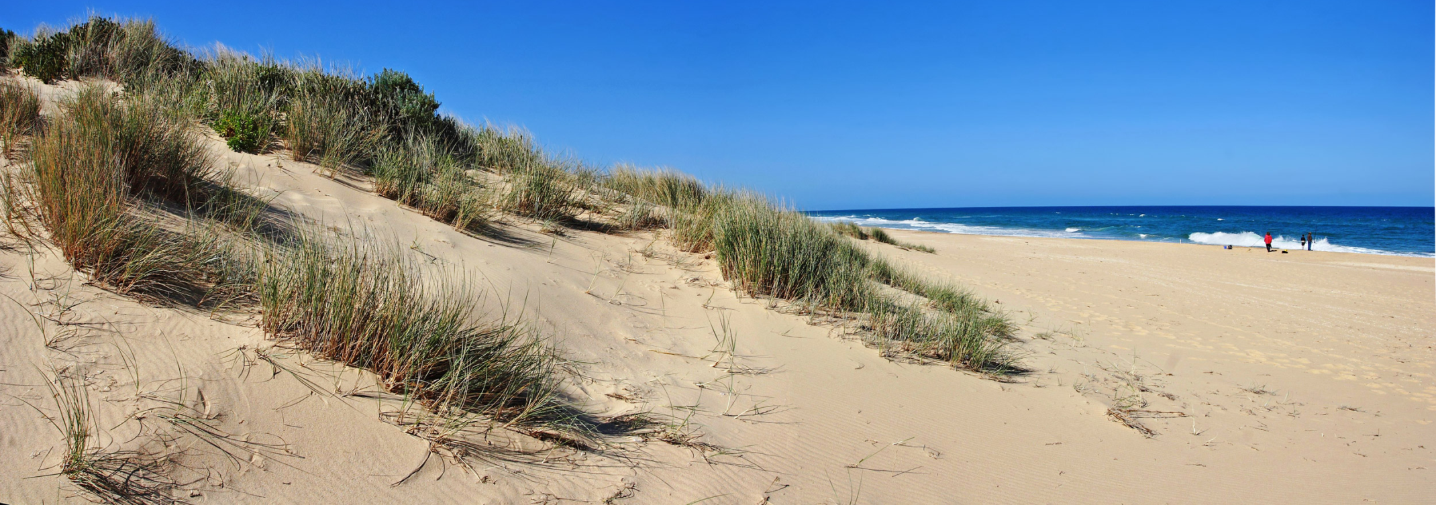
1768—1771

Slide 17
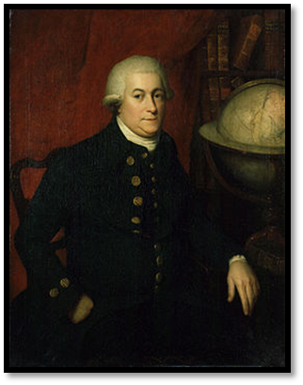
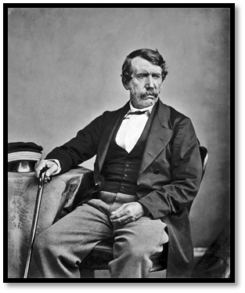
1791
George Vancouver
In 1791 George Vancouver was appointed head of a large marine expedition. Under the command of Vancouver, the western coast of South America, the Sandwich Islands, was investigated, but its most notable research was the Pacific coast of North America and the neighboring islands in of California
1841-1856
David Livingstone
David Livingstone in 1840, sent by the London Missionary Society to South Africa, in 1841-52 he lived among the Bechuan in the Kalahari region, which he investigated from the south. to the north. In 1849 he first reached the lake. In 1855 he returned to the upper reaches of the Zambezi, followed the entire course of the river to the delta, discovered the Victoria Falls (1855) and went to the Indian Ocean near the city of Quelimane in May 1856, thus completing the crossing of the mainland.

Slide 18
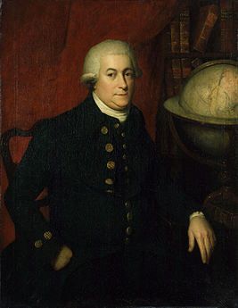
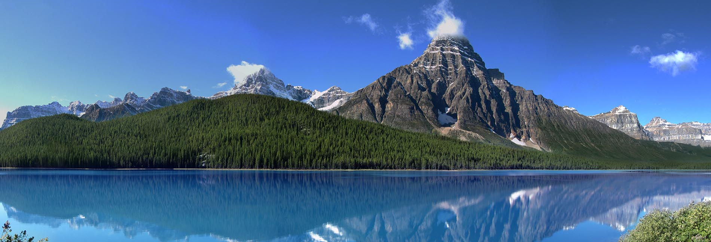
1791

Slide 19
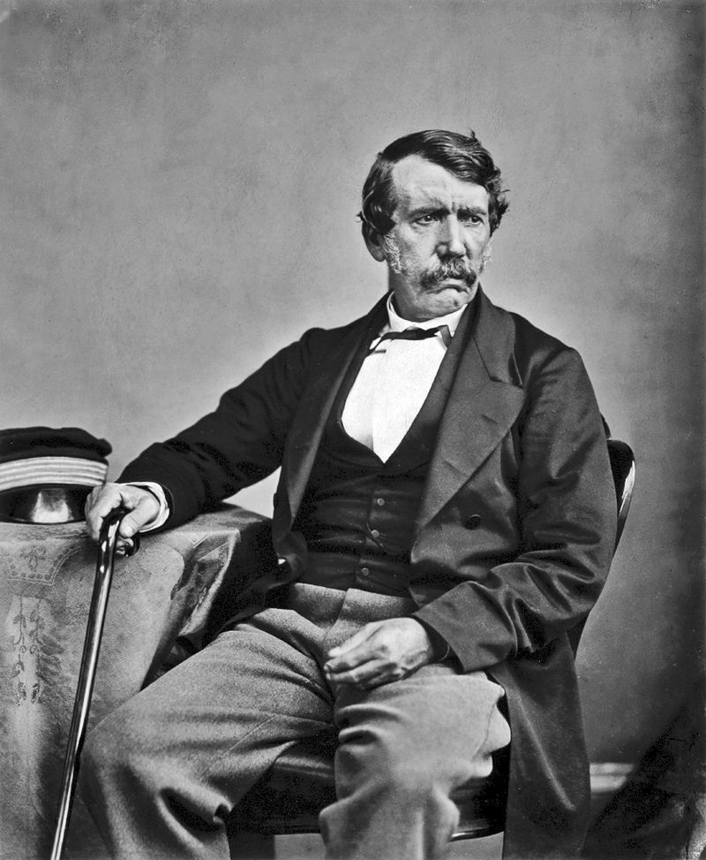
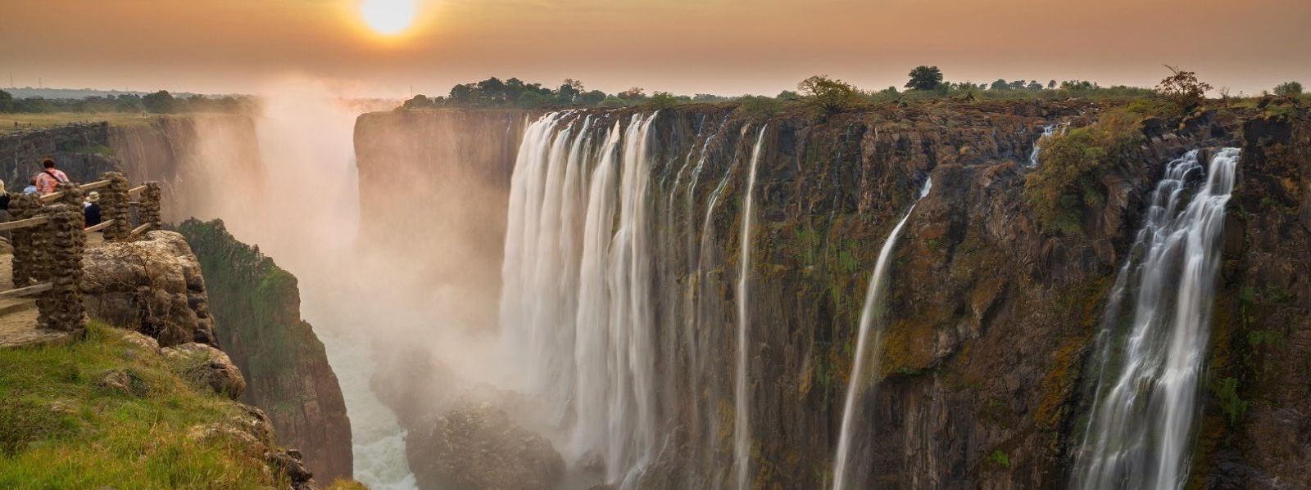
1841-1856

Slide 20
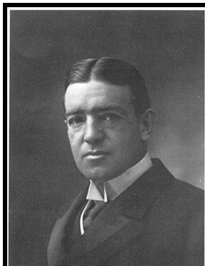
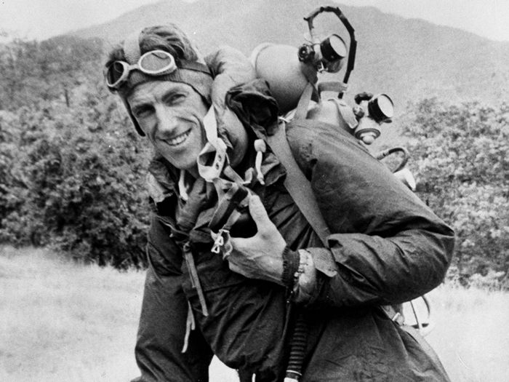
1907
Ernest Henry Shackleton
1901-1903 participated in the Antarctic expedition of R. F. Scott. In the years 1908-1909. headed the expedition on the ship "Nimrod", which was supposed to survey the coast and the deep regions of Antarctica. Commanding one of three units, Shackleton went to the South Pole, but could only reach 88 ° S. w. The expedition mapped a number of points on the coast, discovered a mountain chain on Victoria Land and the Beardmore glacier.
1953
Sir Edmund Percival Hillary
Sir Edmund Hillary A New Zealand explorer and climber, one of two people - first-climbers on Everest. In 1953, Hillary and his Nepalese colleague Tenzing Norgay for the first time in the world reached the summit of Everest, where they left a few chocolates for the gods and made 2 photographs. He was engaged in researching the South Pole and, together with cosmonaut Neil Armstrong, for some reason flew the Atlantic in a two-seater plane. In my opinion, this is the most terrible of his adventures.

Slide 21
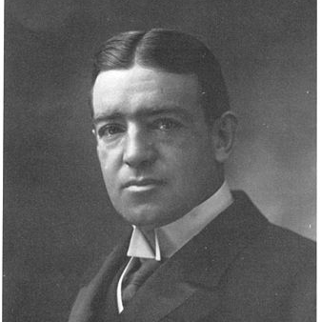
1907

Slide 22
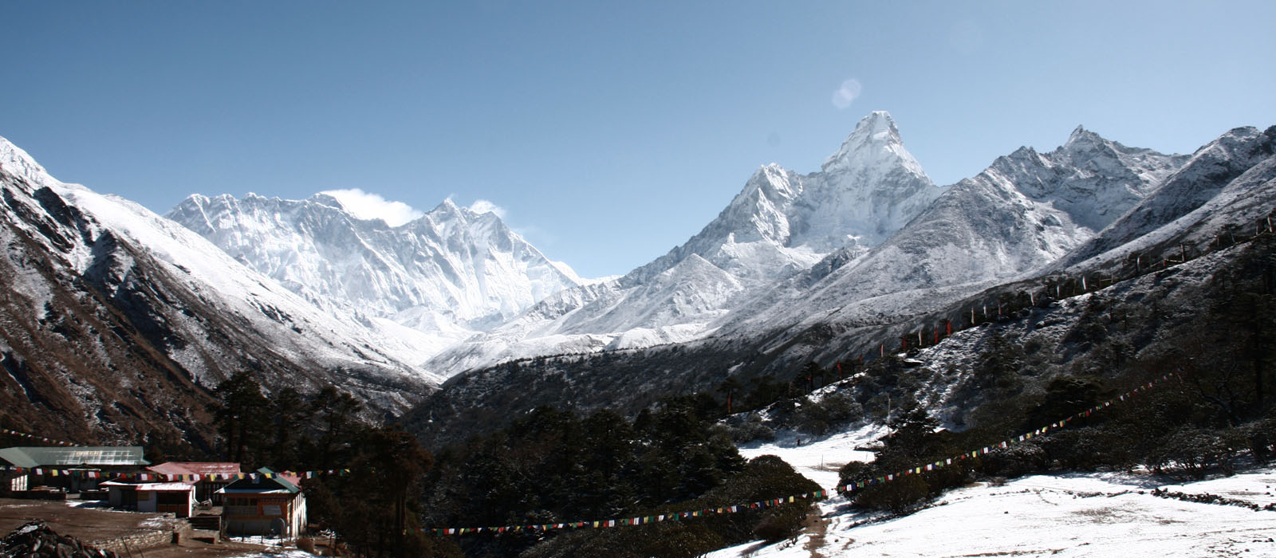
1953

Slide 23
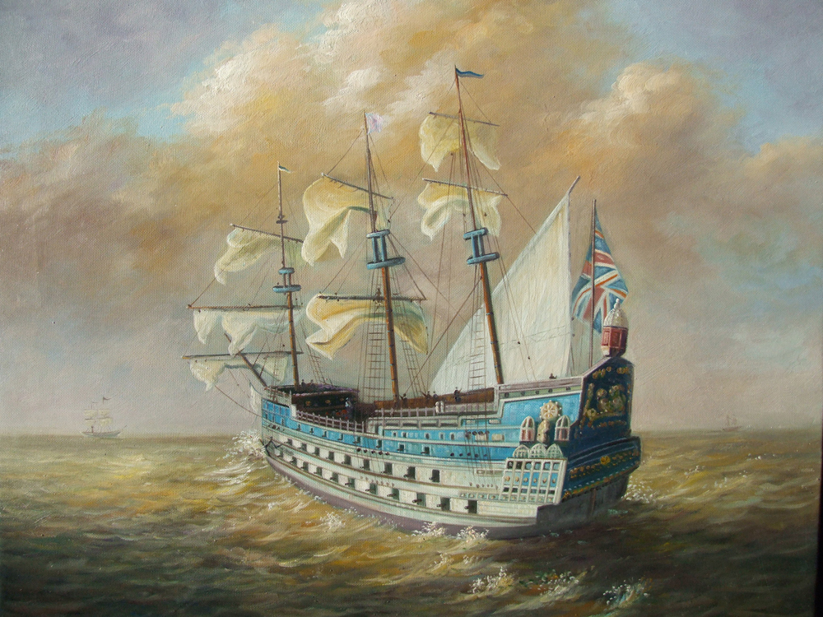
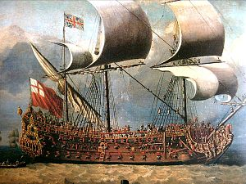
Great geographical discoveries were of world-historical significance. The contours of inhabited continents were established, most of the earth's surface was investigated, a representation was received of the shape of the Earth as a huge sphere and its dimensions. Great geographical discoveries gave impetus to the development not only of geography itself, but of many other areas of natural science, providing new extensive material for botany, zoology, and ethnography. As a result of the Great geographical discoveries, the English first became acquainted with a number of new agricultural crops.

Slide 24
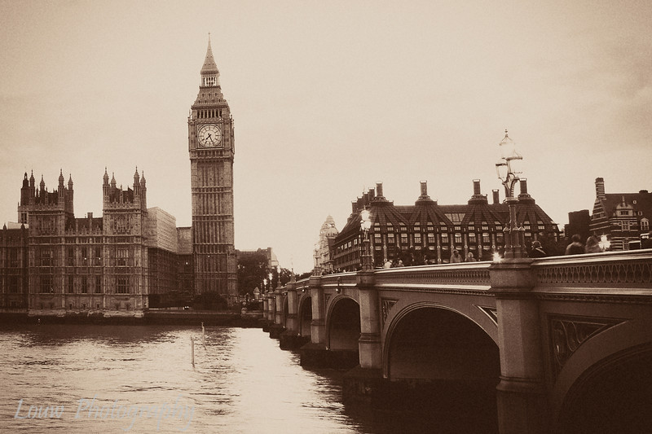
2) Investigate the influence of great world discoveries on culture of Britain.

Slide 25
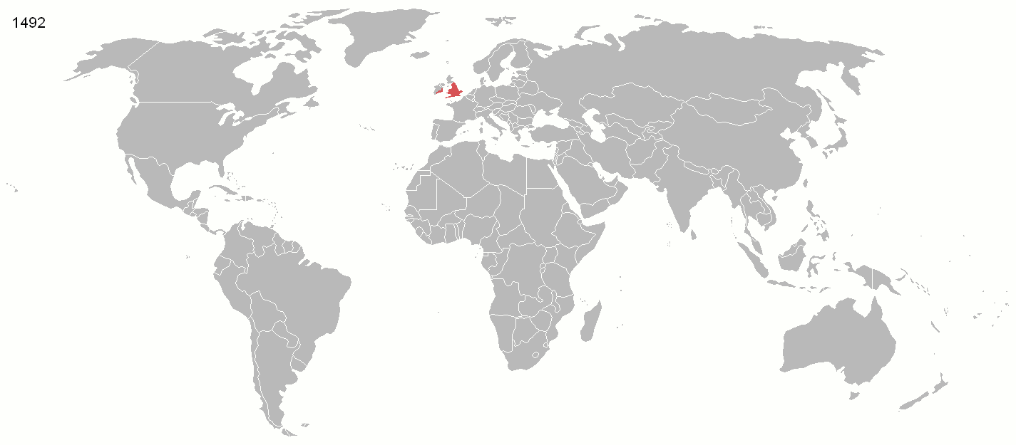
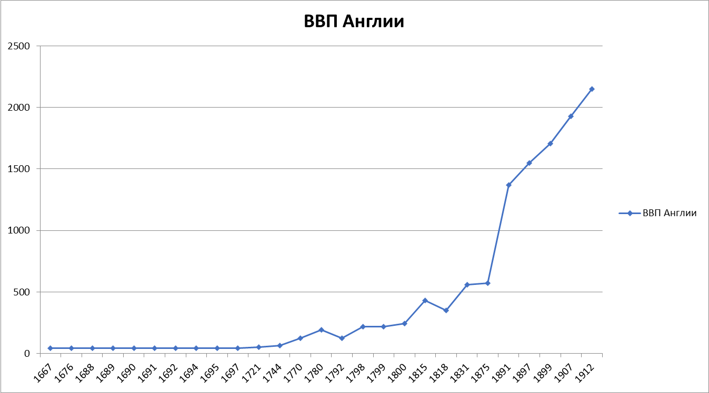
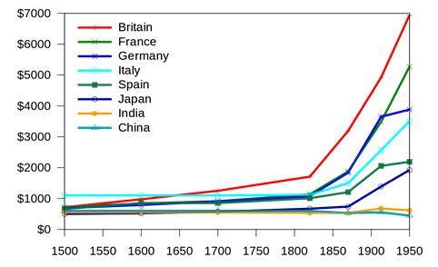

Slide 26
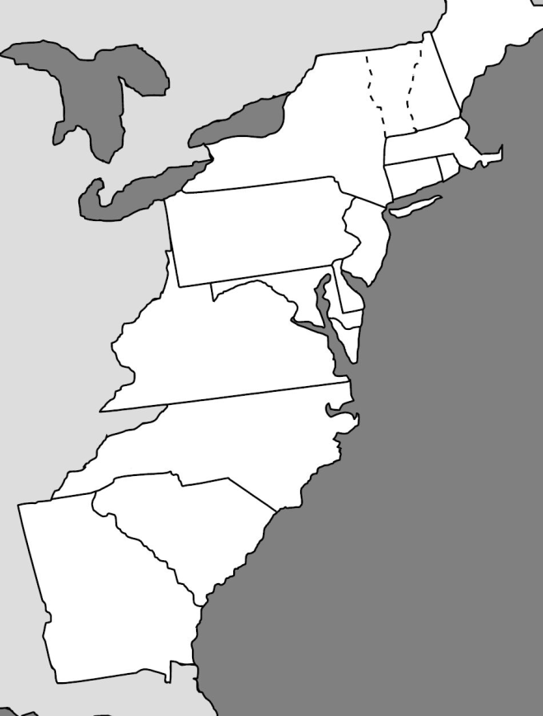
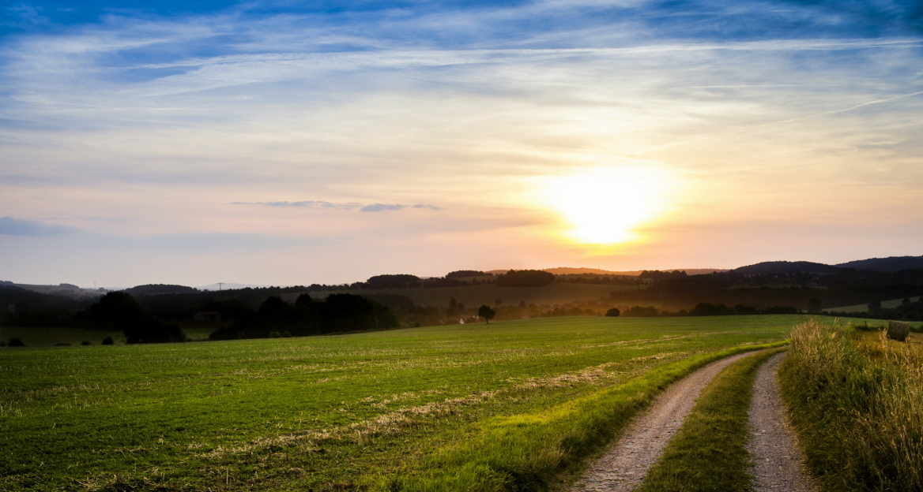
The English, unlike the Spaniards, sought to find vacant land suitable for cultivation. North America was exactly what the British were looking for. The English colonists mastered the natural riches of the new lands with their own labor, and not by plunder. America has become a colony of England. Its population first went slowly, by random people, then a lot of immigrants began to come. A great migration of peoples The great migration of peoples is a conditional name for the totality of ethnic displacement in Europe in the 4th-7th centuries, mainly from the periphery of the Roman Empire. determined the nature and destiny of a new continent with a population of 190 million people. And only after the War of Independence in 1783 the United Kingdom recognized the autonomy of the United States, which promulgated the "Declaration of Independence" by Benjamin Franklin.

Slide 27
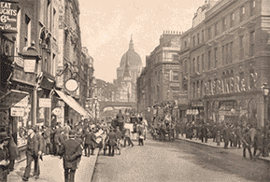
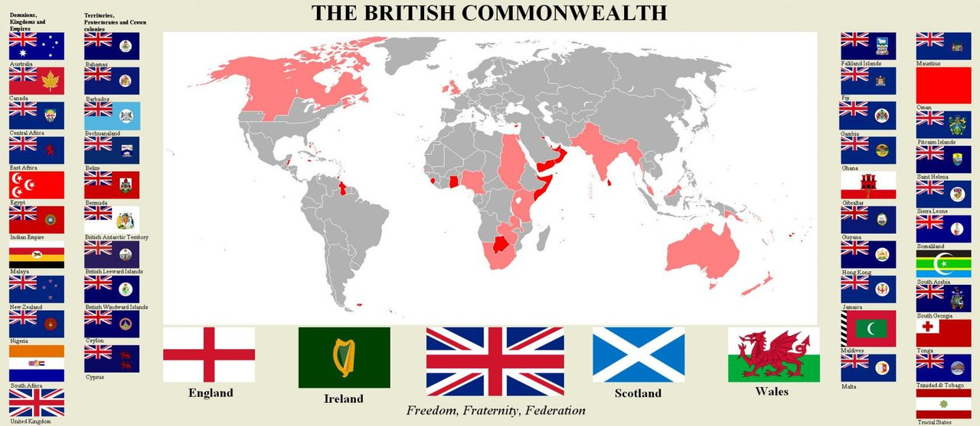
From the above, it can be concluded that the Great Geographical Discoveries significantly influenced the development of the United States. The discovery and settlement of this territory by more educated and developed people led to the emergence of a new powerful state, which at the moment is one of the world powers. And, despite the rapid development of other countries in the world, the United States still performs the function of global leadership and plays the role of a superpower.

Slide 28
As a result of the Great geographical discoveries, the Europeans' view of the world expanded considerably. Europeans discovered two parts of the world, America and Australia, as well as the Pacific, mainly defined the contours of all inhabited continents. Great geographical discoveries have given new vast material for natural sciences, ethnography, and history. Knowing the life of societies with different religions and customs, the Europeans were convinced of the many-sidedness of the world. At the same time, acquiring experience of communication with overseas residents, Europeans were more aware of their cultural and historical identity. Received information about distant countries enriched European literature and art. Great geographical discoveries had a profound impact on the socio-economic processes in Europe, contributed to the initial accumulation of capital. The colonies served as sources of raw materials and markets for European goods.

Slide 29
Information:
http://discover-history.com/
https://ru.wikipedia.org/wiki
http://www.history-names.ru
https://tv-english.club/ru/
http://esparus.com/seafarer/
http://www.krugosvet.ru
https://www.royalnavy.mod.uk/

