Slide 2
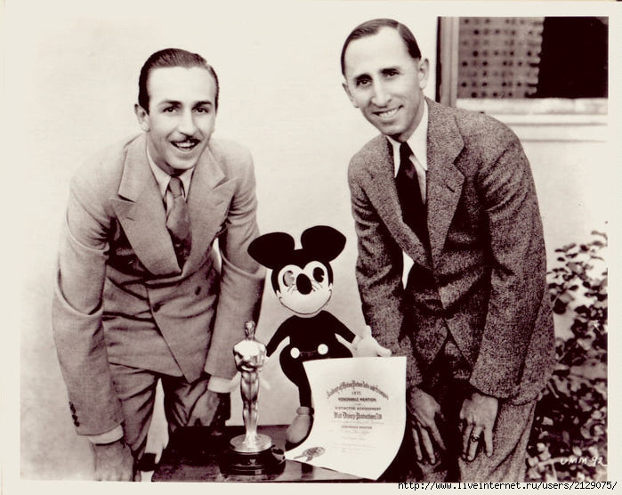

Slide 3
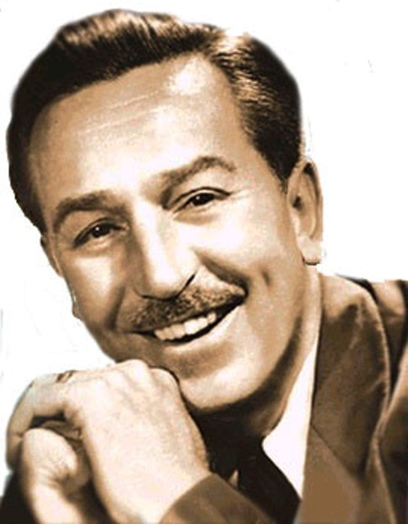
Walt Disney
05.12.1901 - 15.12.1966

Slide 4
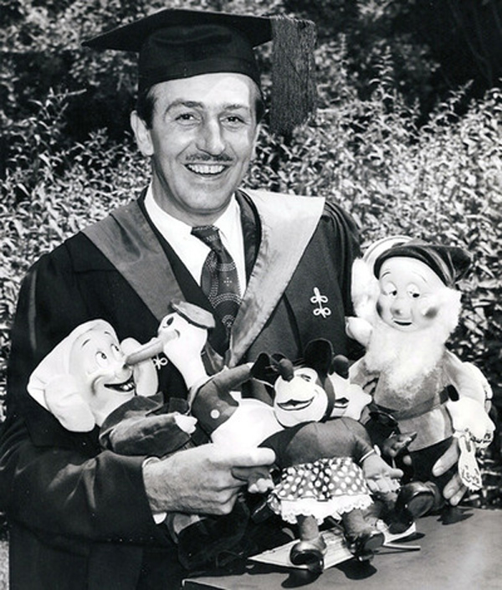

Slide 5
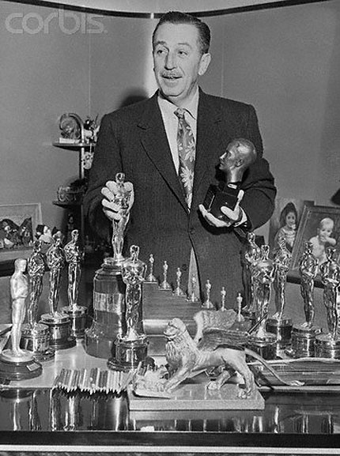

Slide 7
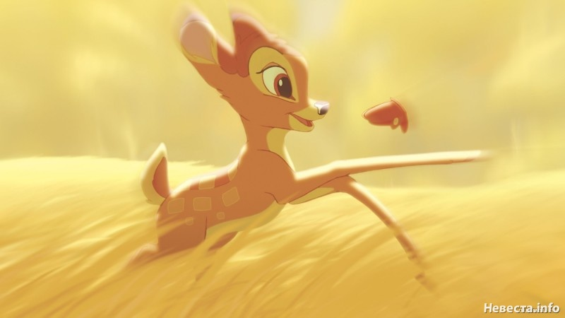

Slide 8
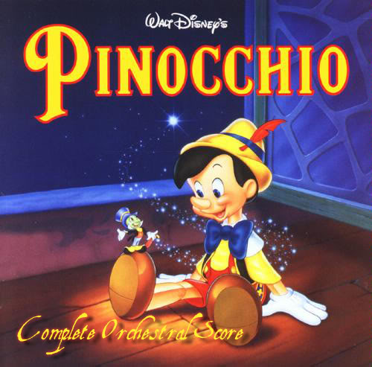

Slide 9
How much do you know about Walt Disney?
Walt Disney was born in … .
A the US B the UK C Australia
He sold his first drawing at the age of … .
A 2 B 7 C 20
He received … Academy Awards in his lifetime.
A 2 B 32 C 12
He made … films while he was alive.
A 91 B 41 C 81

