Slide 1
TANGO WITH DEATH
made by Kutuzova Eva, 11A
teacher: Kodintseva Tatiana Vasilievna
Lobnya, 2020

Slide 2
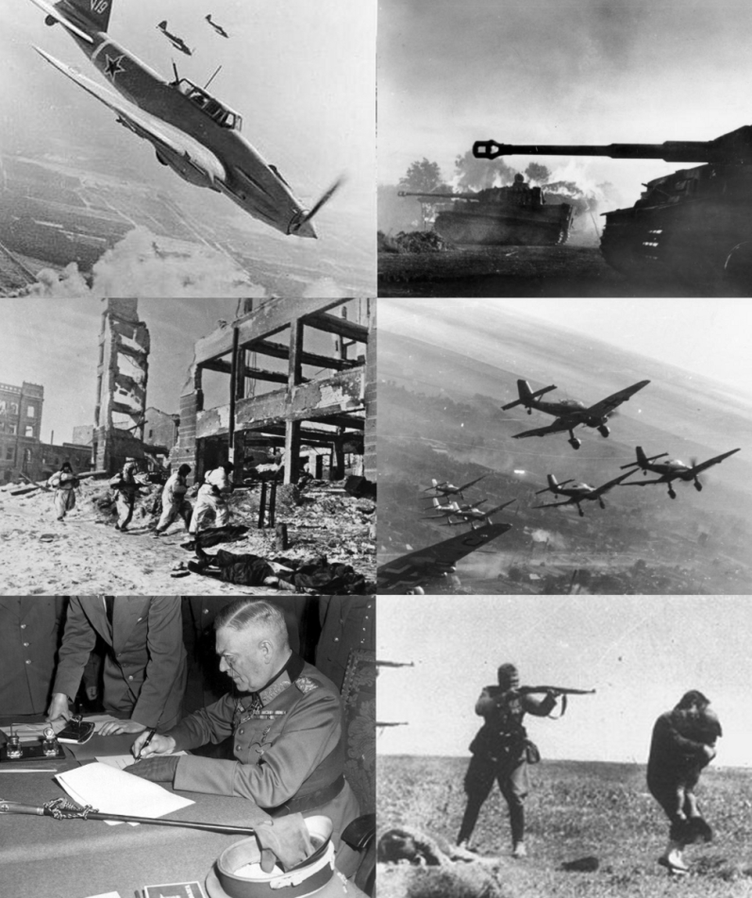
T h e G o a l s
To find out information about the Second World War, the “night witches”, flighter pilot Maria Popova and present it to the audience; to make a conclusion

Slide 3
When did the World War II start?

Slide 4
Name one of the heroes of the War

Slide 5
Do you know who the Night Witches are?

Slide 6
Name one of the Night Witches

Slide 7
Name one person that lived in our town and was on the War

Slide 8
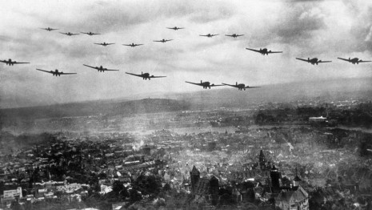
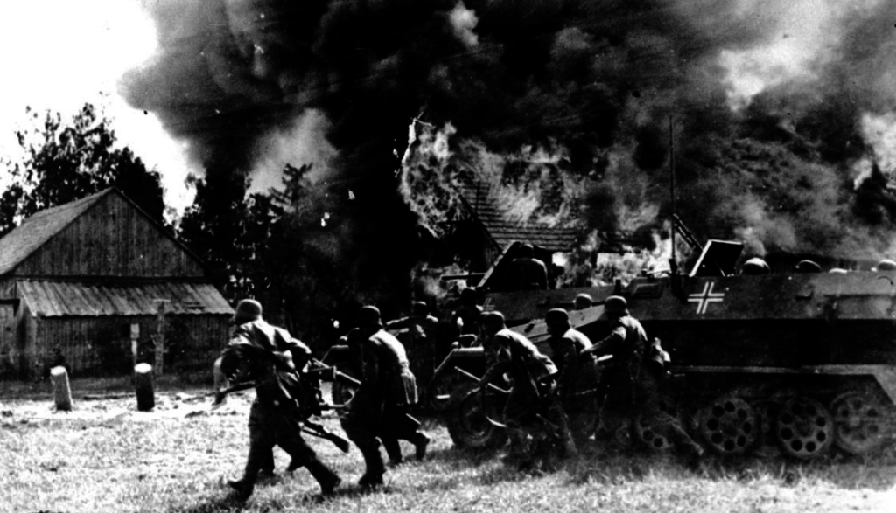
The Second World War
The Second World War
The Second World War was the largest military conflict in history. The rise of Hitler and Nazi Germany in the late 1930s brought unimaginable suffering to millions of people. Hitler was defeated in 1945

Slide 9
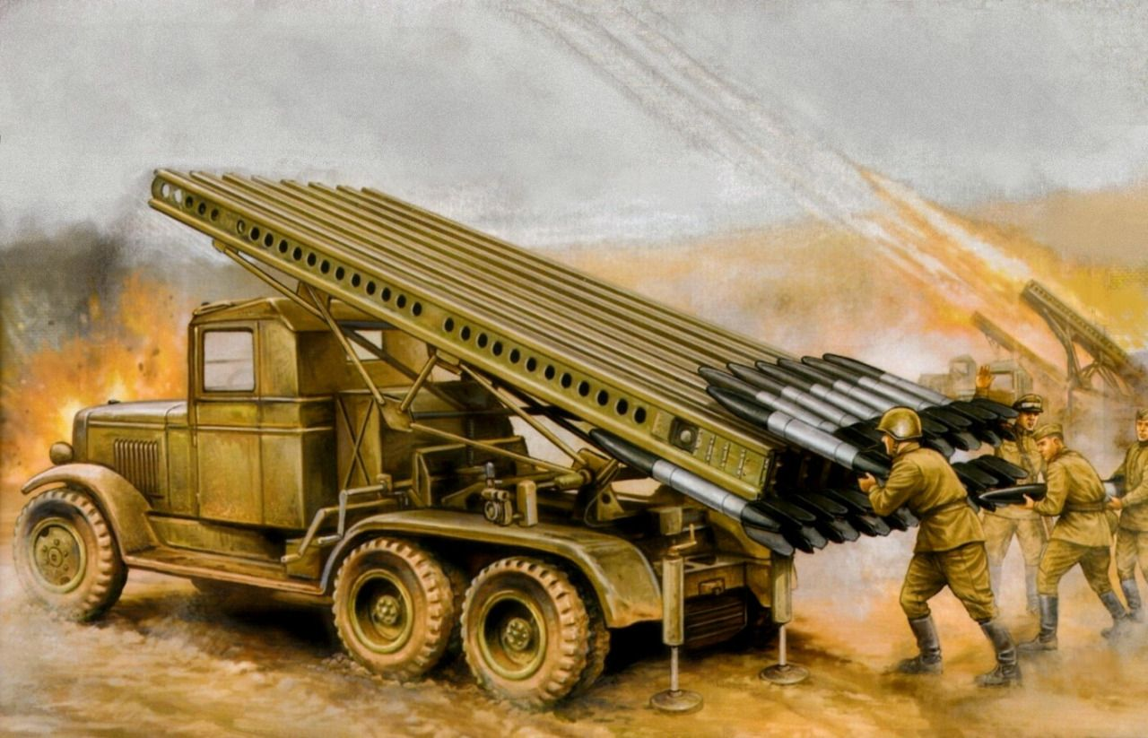
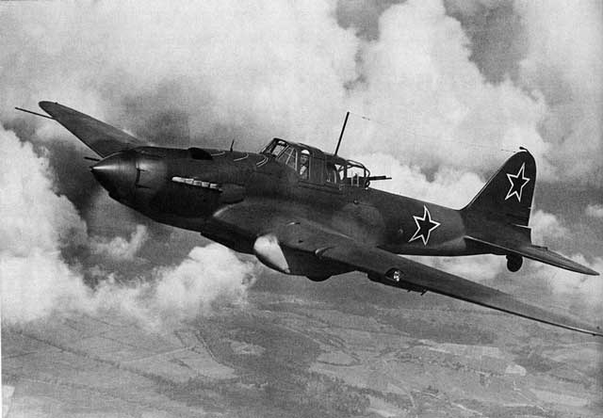
The Second World War
The Second World War
Katyusha rocket launcher
Developments in military technology, like the world-famous Katyusha rocket launcher and Shturmovik bomber, were important
Shturmovik bomber

Slide 10
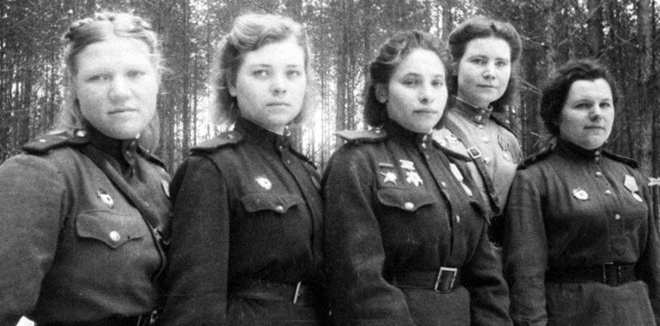
Women Take Part in War
The Soviet Union was the only country in the world where women not only took care of fields and factories but also fought shoulder to shoulder with men as front line soldiers
It was also the only country where women could become fighter pilots

Slide 11
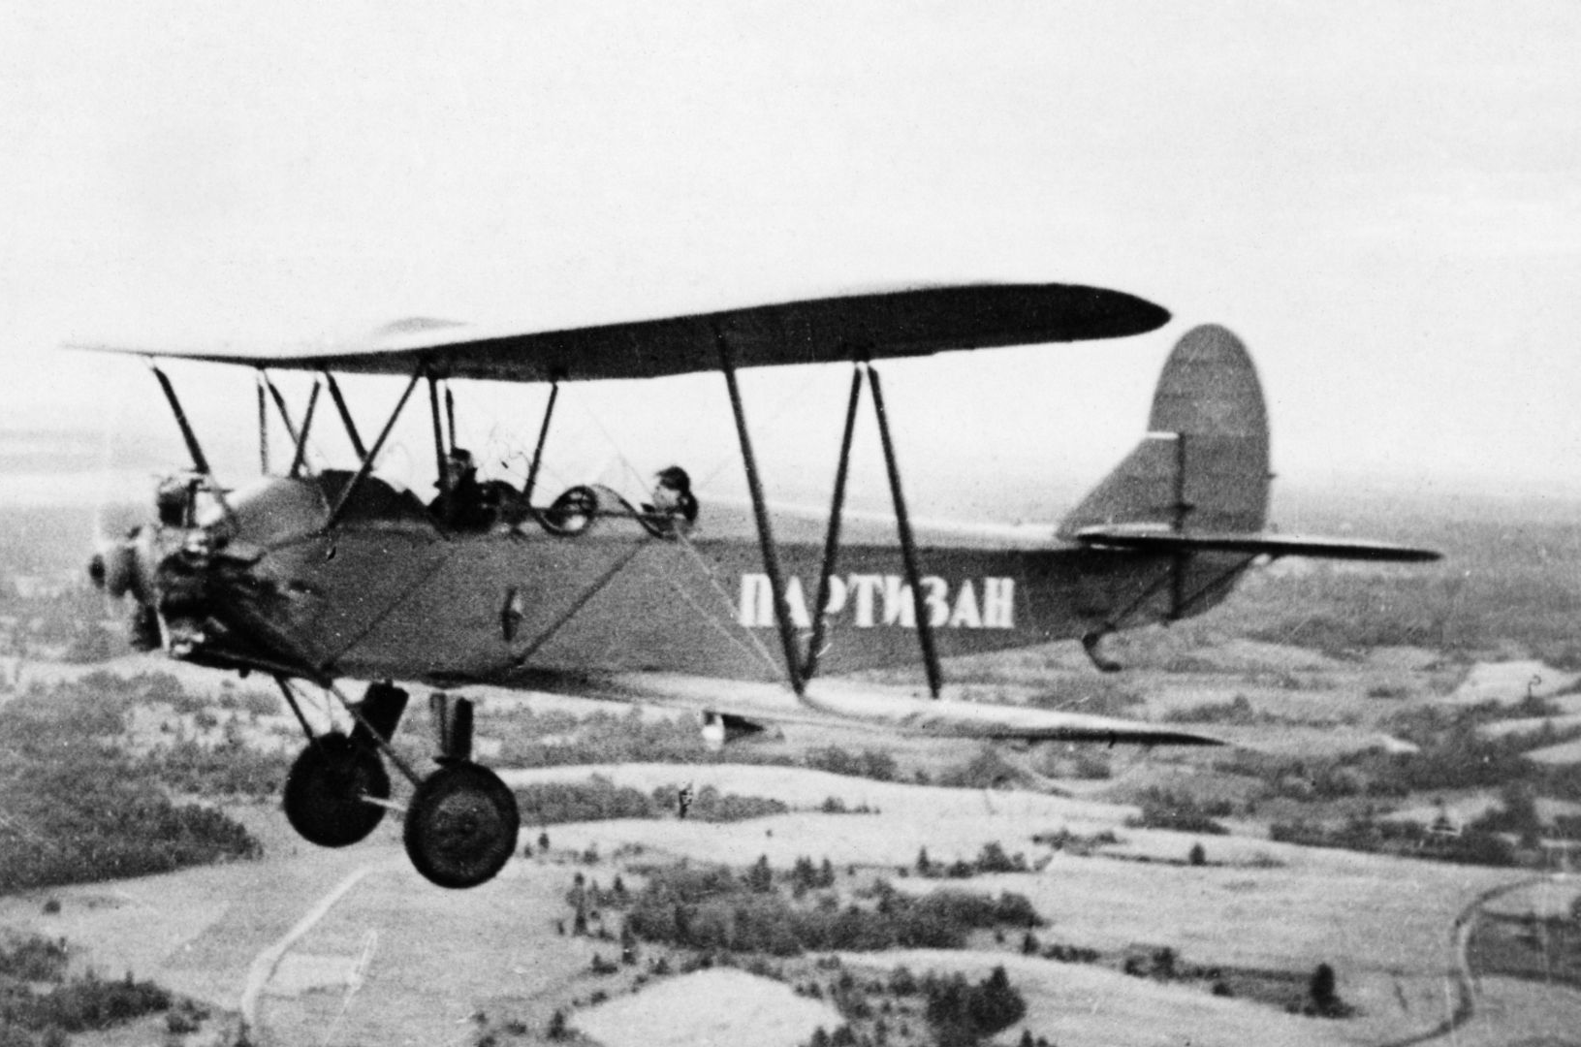
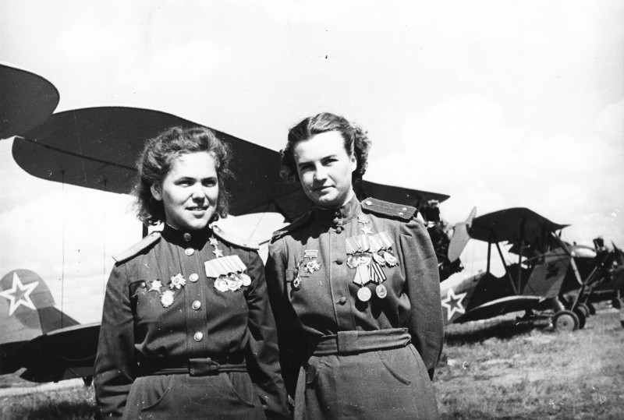
Women Take Part in War
PO-2 plane ‘kukuruznik’
The girls often flew old Po-2 planes known as ‘kukuruzniks’.

Slide 12
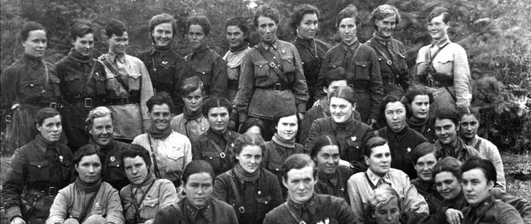
The Night Witches
It was the women’s regiments that learnt to fly at night with their engines switched off and attack the enemy unexpectedly
The Germans feared them and called them the ‘night witches’

Slide 13
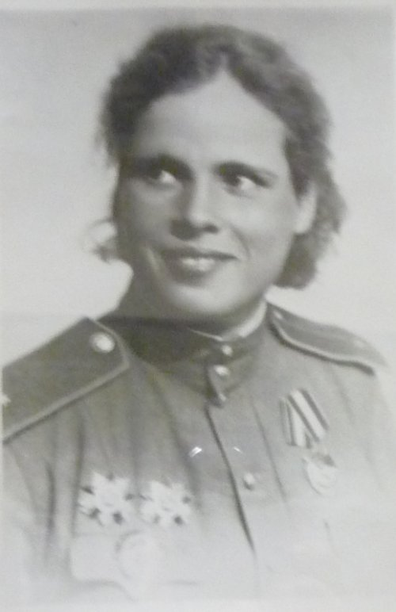
Maria Popova
She was born in 1917 in the Urals near the town of Sverdlovsk. Maria went to teachers' college, and then the Komsomol leader of college suggested to enter a pilots' school in Bataisk. . Maria Popova was nineteen when she entered pilot training.

Slide 14
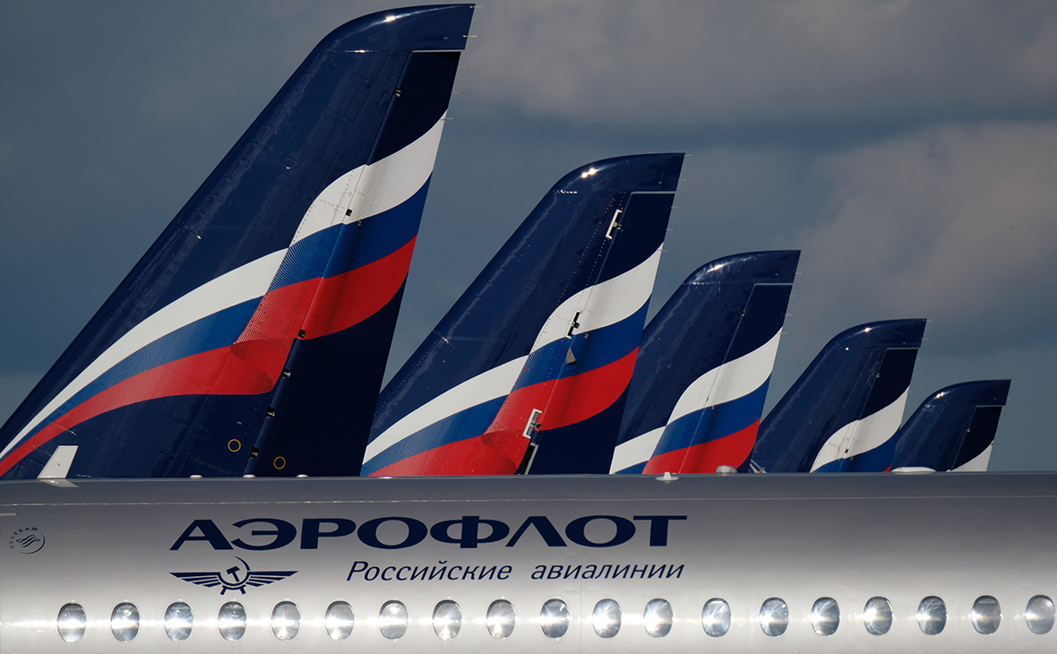
Maria Popova
When Maria graduated she flew as a pilot with Aeroflot, our national airline. She had been flying with the airline for two years when the war broke out

Slide 15
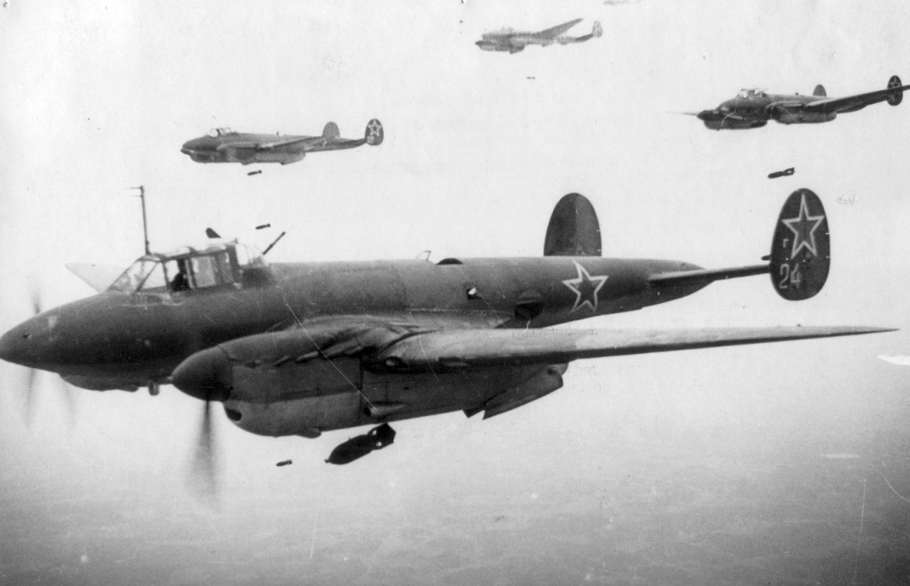
Maria Popova
They wanted her to join the 125th Dive Bomber Regiment flying the Pe-2, because she had by then over 900 flying hours
She went to Moscow to military headquarters

Slide 16
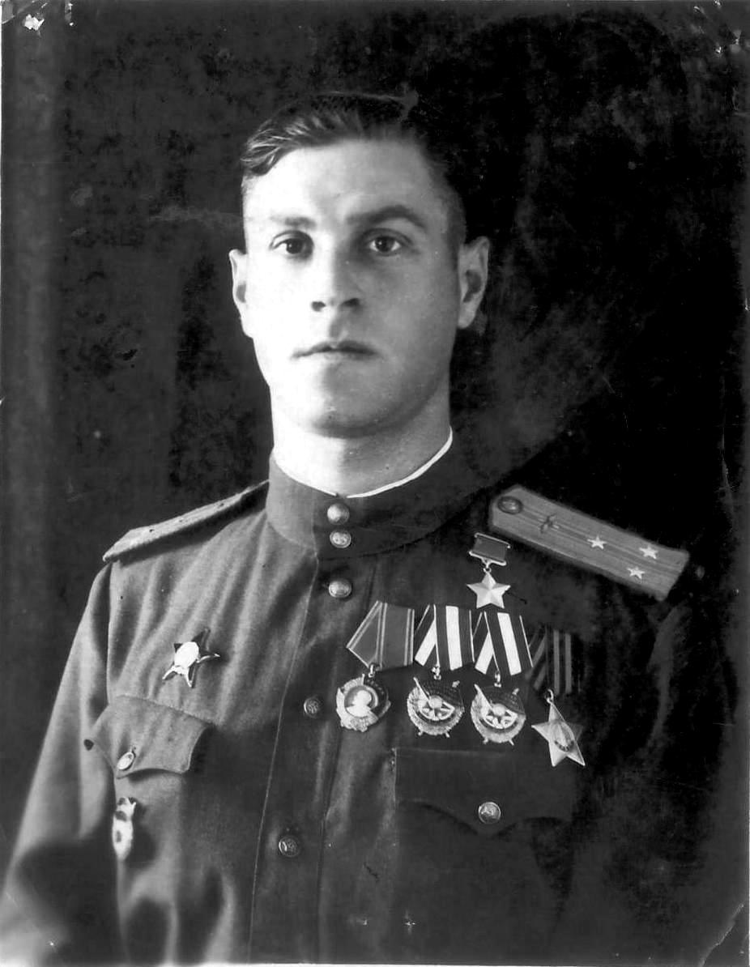
The personnel officer said:
"Oh, since he was my best friend, and you are a Tepikina too, I'll let you join the 46th regiment"

Slide 17
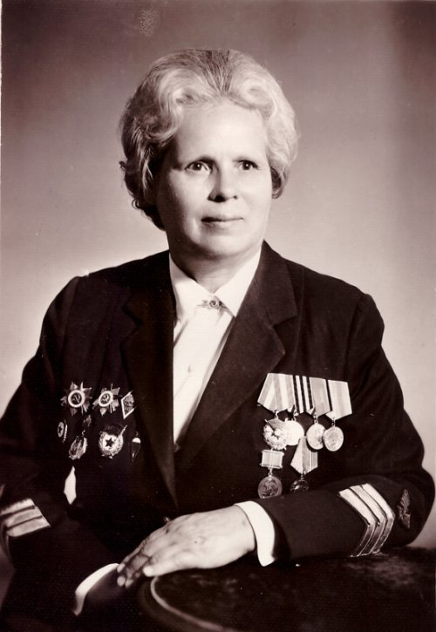
Maria Popova
Maria Popova joined the regiment in August, 1943, and flew her first combat mission a week later. She learned to see in the dark and to determine target visually. It took practice to recognize objects in the darkness
.

Slide 18
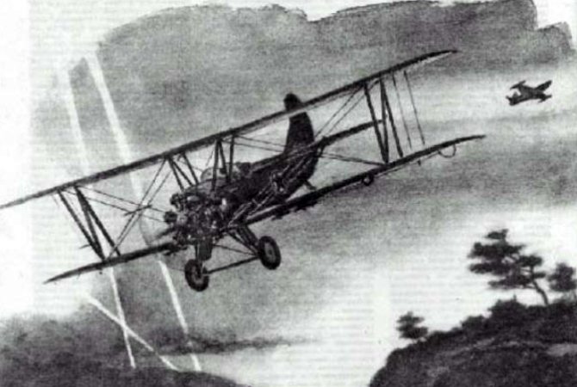
Maria Popova
Once she was flying a mission, and with forty-five seconds remaining before dropping bombs, they were caught first by one searchlight and then by some twenty more searchlights

Slide 19
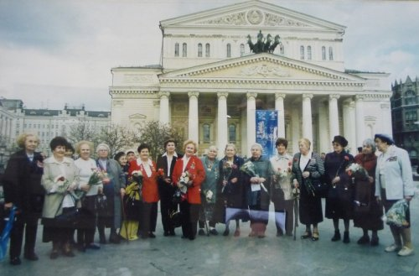
C
O
N
C
L
U
S
I
O
n
After the war, the three women’s regiments were broken up. Every year there are fewer and fewer of them left to tell their story. People say that without the past, there can’t be any future, so it is important to remember and appreciate what those amazing women did for us

Slide 20
Literatura
museum-lobnya.mo.muzkult.ru
Wikipedia.org
Speak Out, Cvetkova, Glossa Press, 2011
A Dance with Death, Anne Noggle, Texas A&M University Press

