Slide 1
St Valentines Day

Slide 2
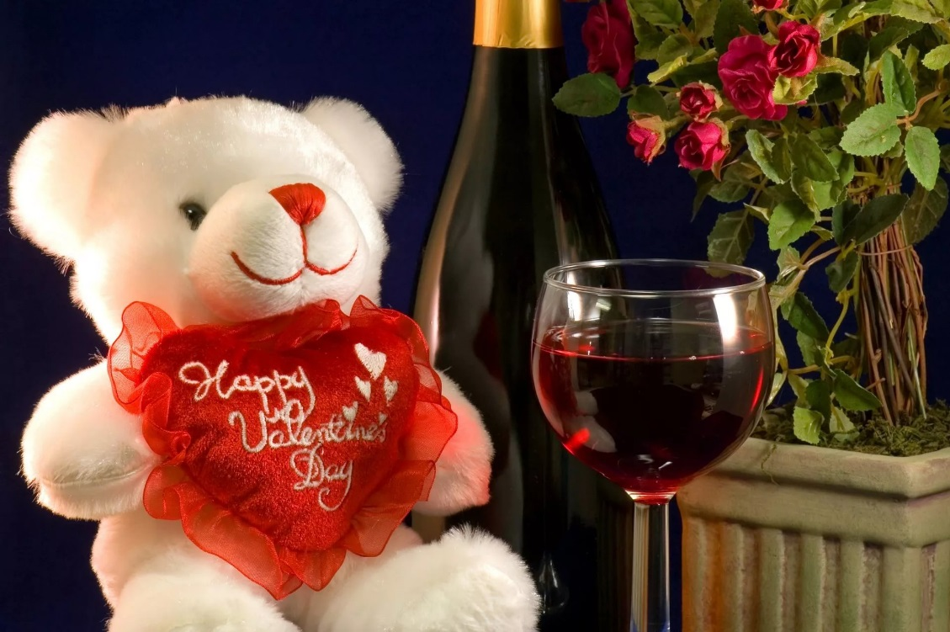
You know, the day is most closely associated with the mutual exchange of love notes in the form of "valentines." Valentine symbols include the heart-shaped outline, doves, and the figure of the winged Cupid. Since the 19th century, handwritten notes have largely given way to mass-produced greeting cards.

Slide 3
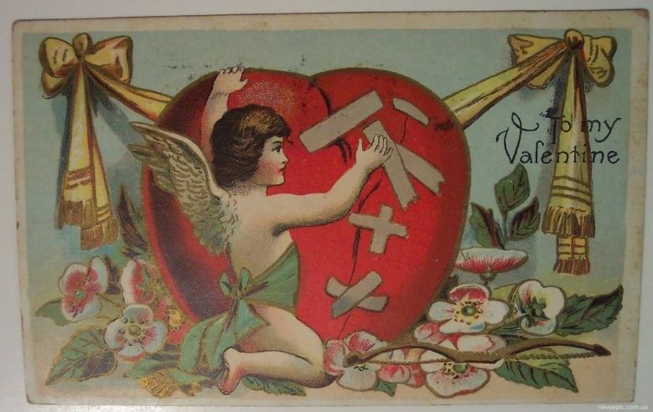
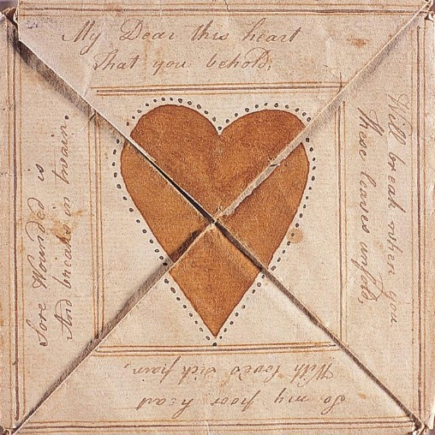
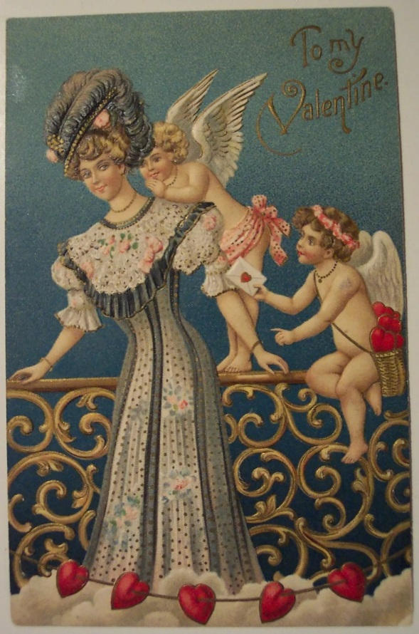
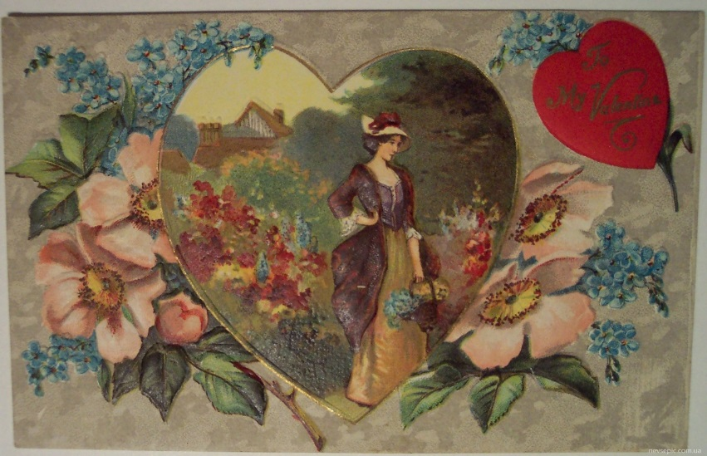
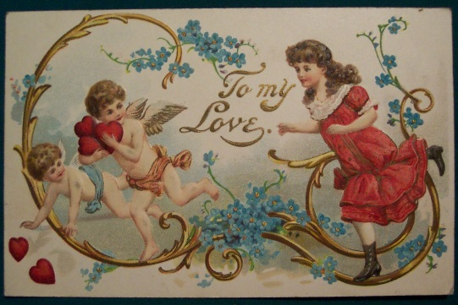
The sending of Valentines was a fashion in the nineteenth century in Great Britain. They were the same as you can see here.

Slide 4
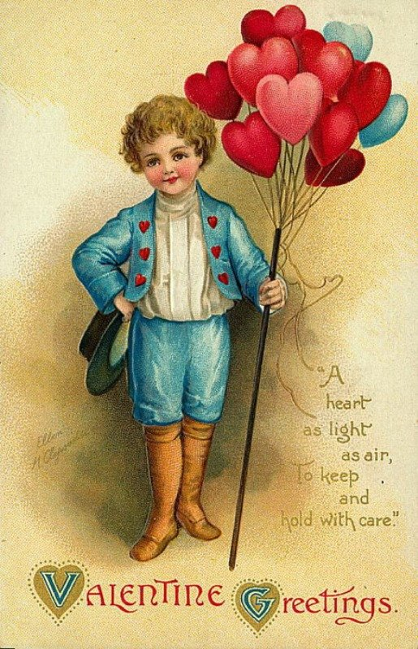
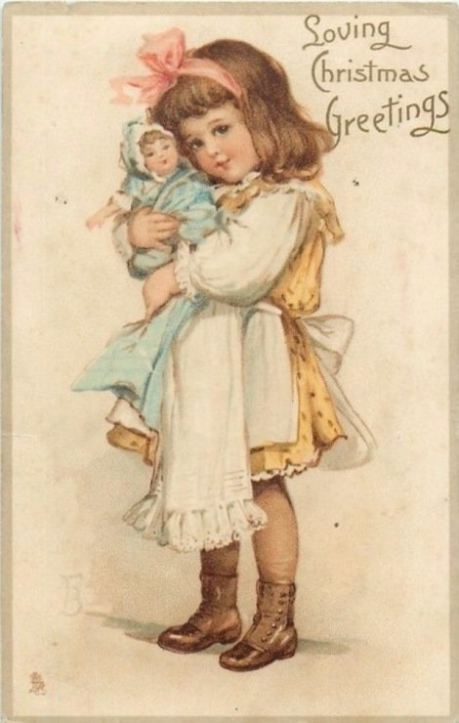
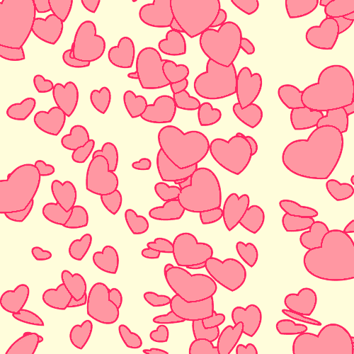
Also there аre children’s and black American Valentines.

Slide 5
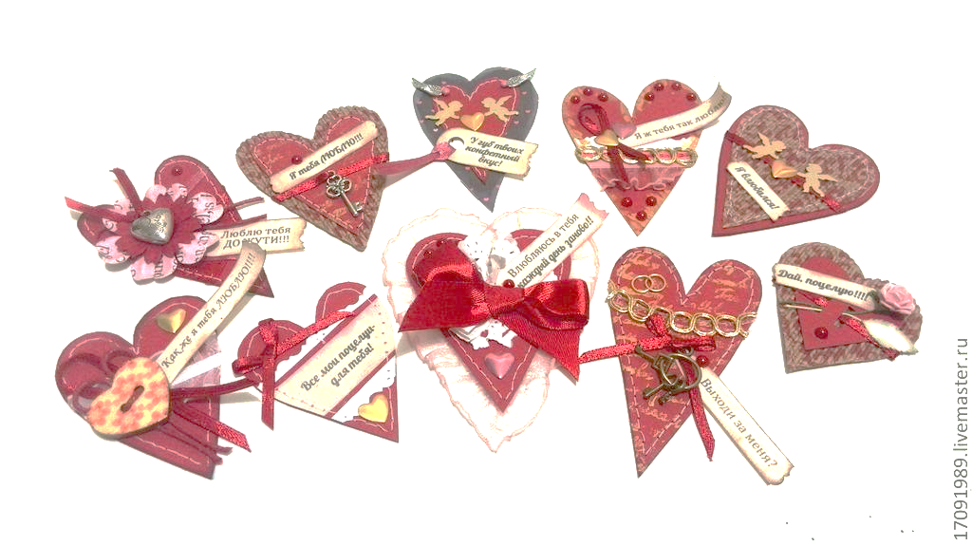
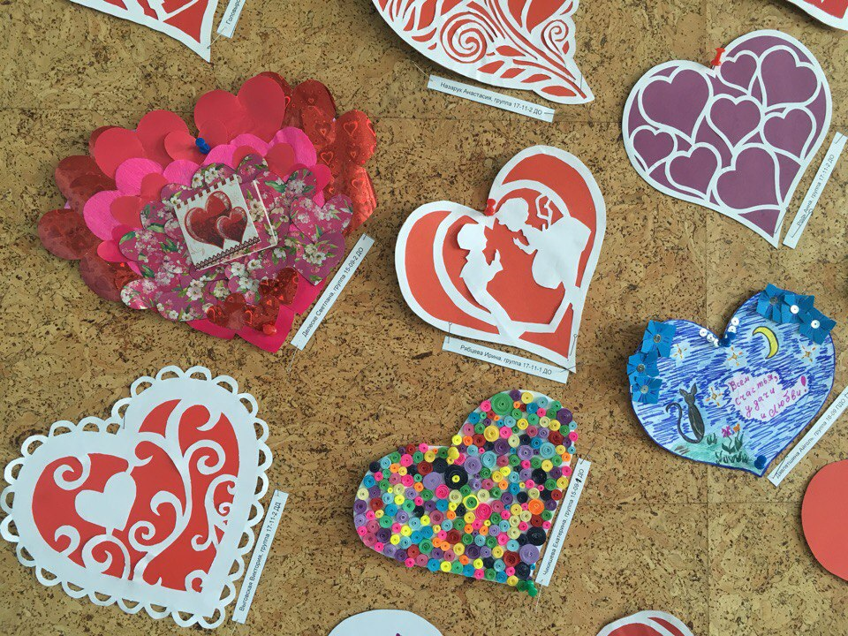
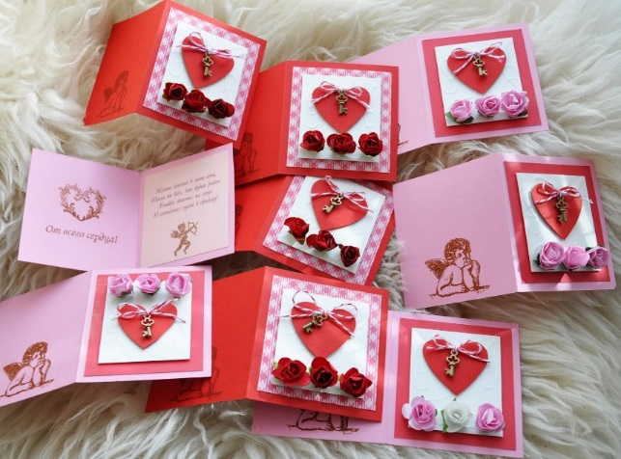
And here there are well-known modern valentines.

Slide 6
Valentine quiz

Slide 7
1. Valentine fell in love with the…
Queen
|Nurse
Prisoner’s daughter

Slide 8
2. According to a popular belief, why was St. Valentine beheaded?
Because he was always in love with someone
He secretly married young couples
He ran away with Emperor Claudius’s daughter

Slide 9
3. According to English tradition – what happens to the 1st man, that a woman sees on St. Valentine’s day?
She/ll marry him
He’ll die
She’ll kiss him

Slide 10
4.Where did St Valentine live?
in Greece
in Rome
in Great Britain

Slide 11
5. Which Roman God is the symbol of St Valentine’s Day?
Eros
Apollo
Cupid

Slide 12
6. When did valentine’s cards become popular in the UK?
19th century
15th century
16th century

Slide 13
7. The girl St Valentine fell in love with was
Deaf
Blind
Deaf and blind

Slide 14
Couples

Slide 15
You are here to match the famous couples
CARMEN
ADAM
CARMEN
EVE
NAPOLEON
EVE
JOSEPHINE
KEN
JOSEPHINE
CLEOPATRA
DON JOSE
CLEOPATRA
JULIET
JULIET
RHETT BUTLER
BEAUTY
BEAUTY
MICKEY
YOKO
YOKO
ROMEO
SCARLETT O’HARA
SCARLETT O’HARA
THE BEAST
MINNEY MOUSE
MINNEY MOUSE
MARK ANTHONY
BARBIE
BARBIE
JOHN LENNON

