Slide 1
The British Museum
Created by Lugovskaya Anastasia 9 “Б”

Slide 2
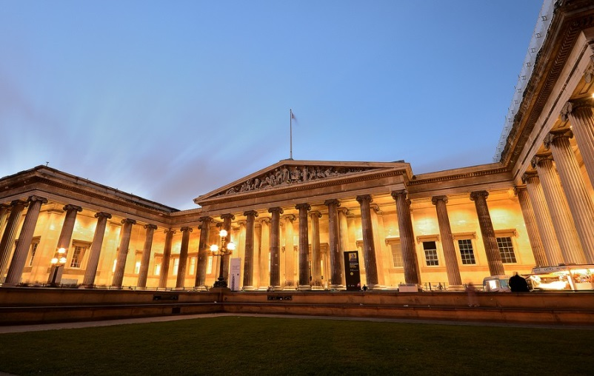
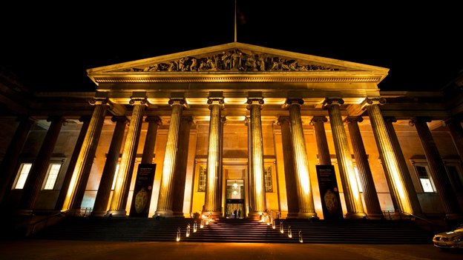
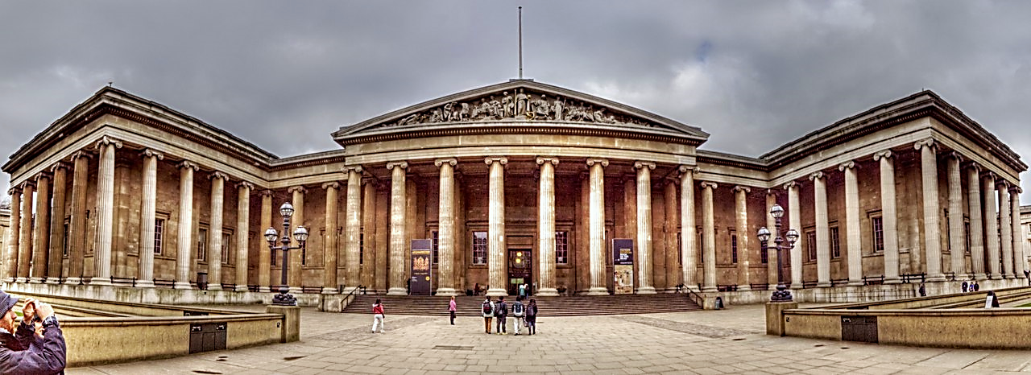
British Museum – the main historical and archaeological Museum UK and one of the largest museums in the world, the second most visited after the Louvre. It Located in London

Slide 3
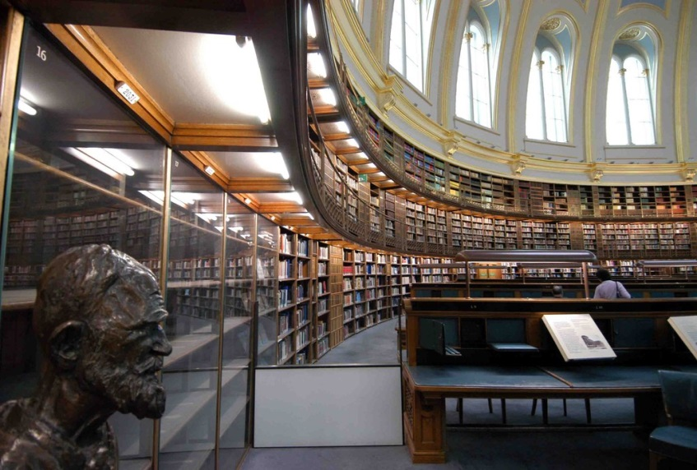
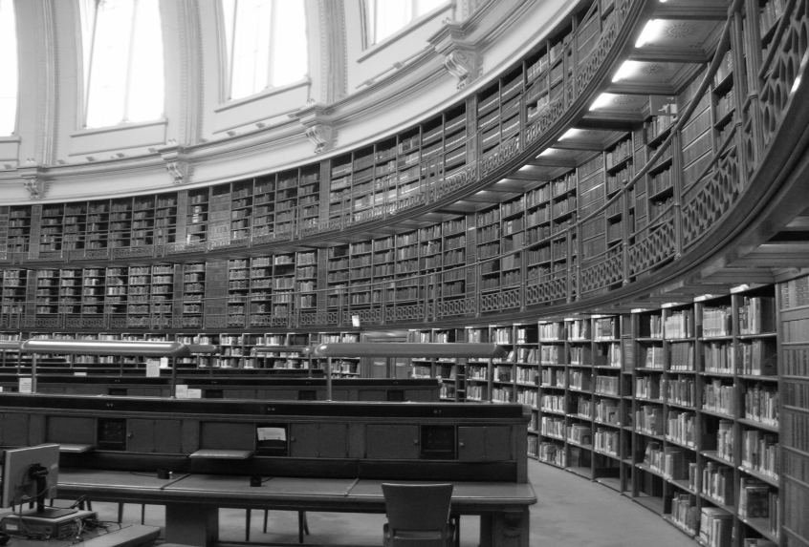
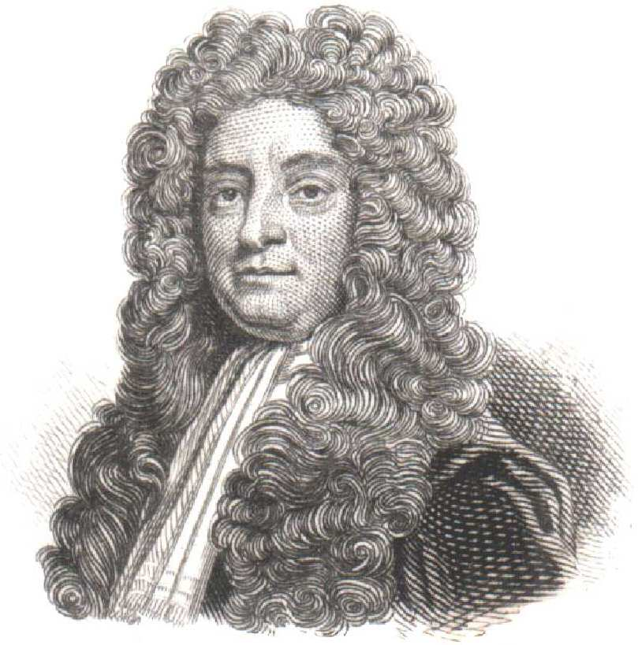
The Museum was based in 1753 on two collections — the collection of the famous British doctor Hance Sloan and the library of the antiquarian Robert Cotton, who became the Foundation of the great British library. The creation of the Museum was approved by an act of the British Parliament. The British Museum was the first Museum in the world of a new kind, belonging people.

Slide 4
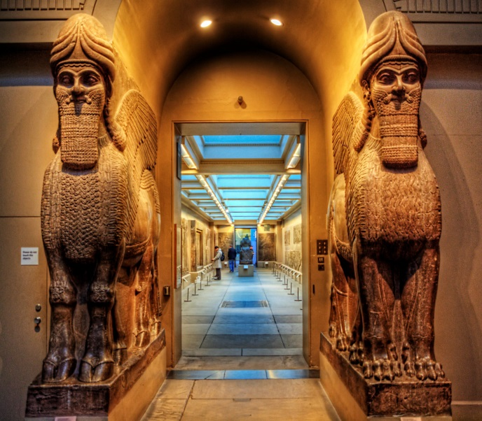
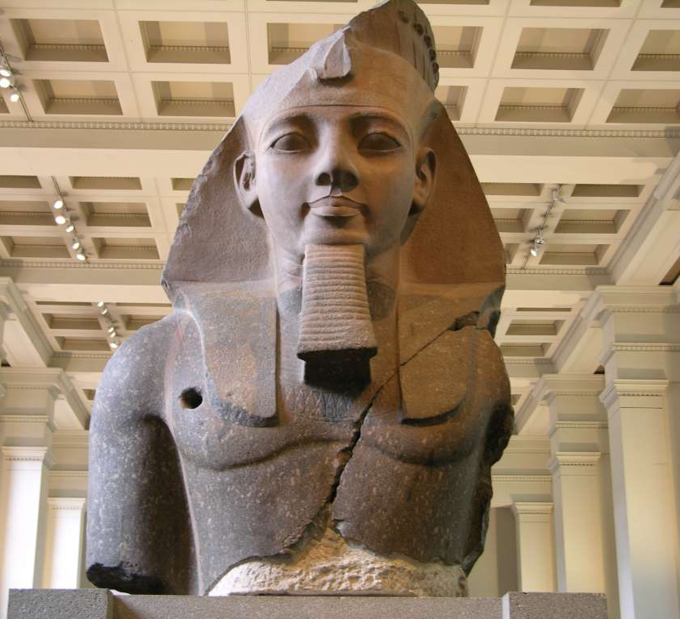
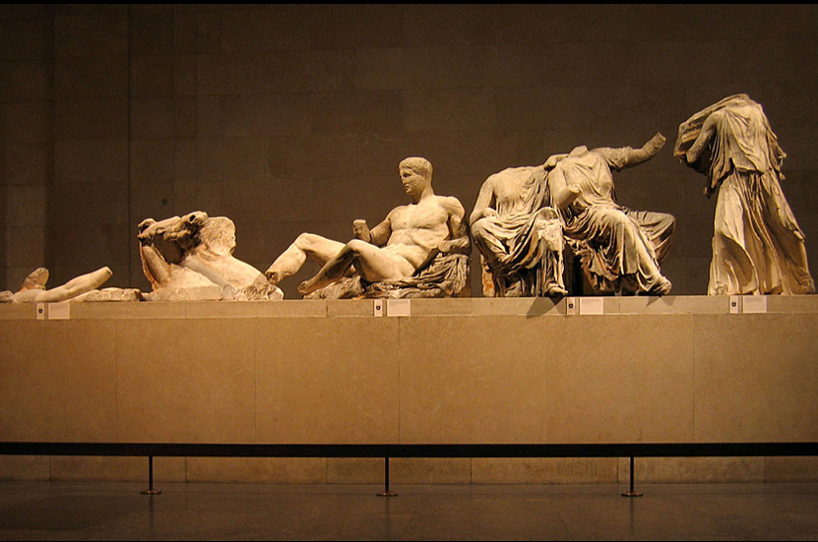
Items from the British Museum's collections are in 100 galleries. Most of these exhibits are selected by territorial and chronological principle, but there are thematic exhibitions.
Now in the British Museum are nearly eight million items.

Slide 5
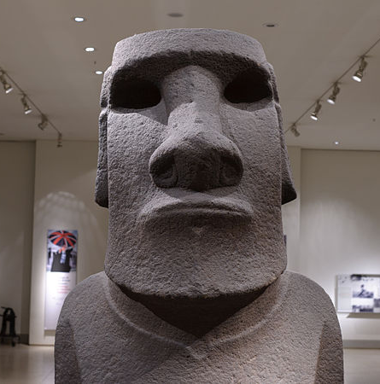
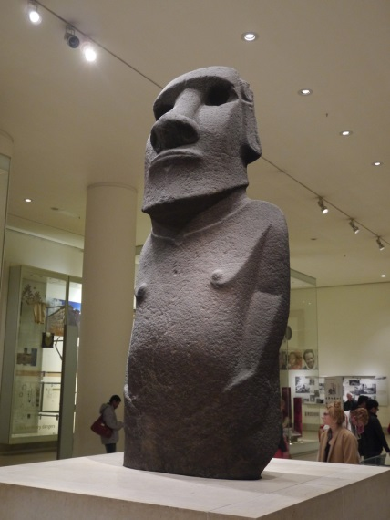
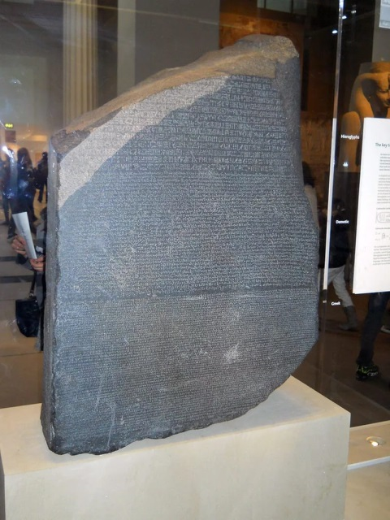
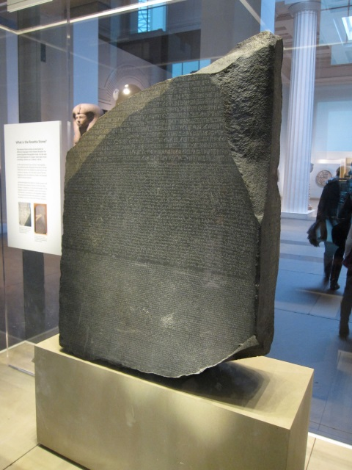
British Museum has antiquities from around the world, but are the most interesting exhibits:
Rosetta stone with lyrics, made in the 196 BC. Artifact joined the Egyptian exhibition in 1802
Hoa Hakananai is statue from Easter island, made of basaltic tuff - material of volcanic origin. Translated Hoa Hakananai means "lost and hidden friend"

Slide 6
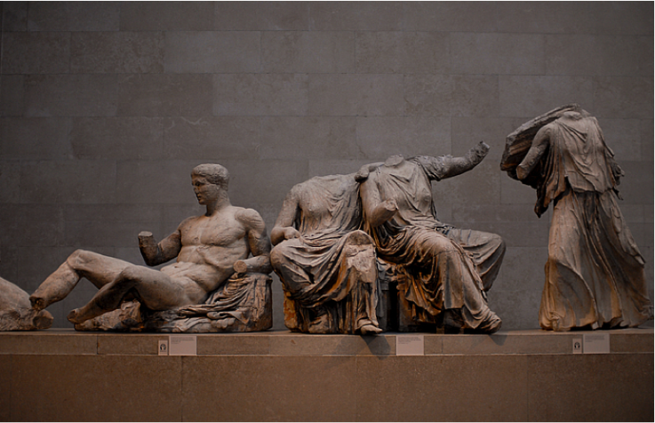
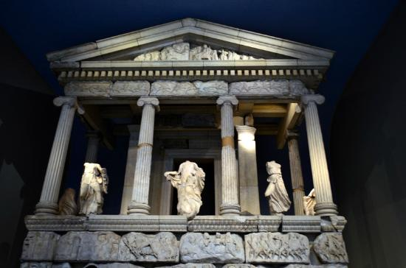
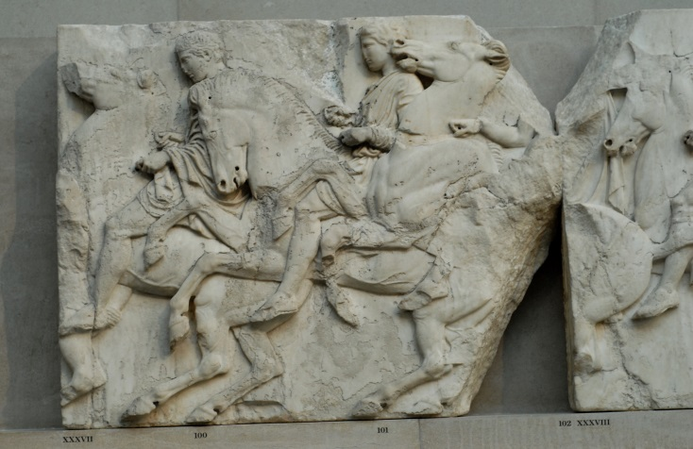
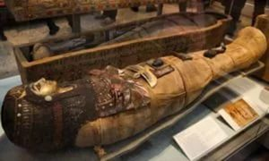
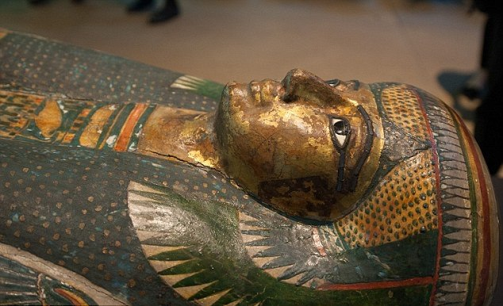
Ancient sculptures of the Parthenon. And like Greece, neither asked to pass belonging to her great statue, they remain in the UK
The mummy of the high priestess of Amon-RA by the name of Katabat, which about three and a half thousand years

Slide 7
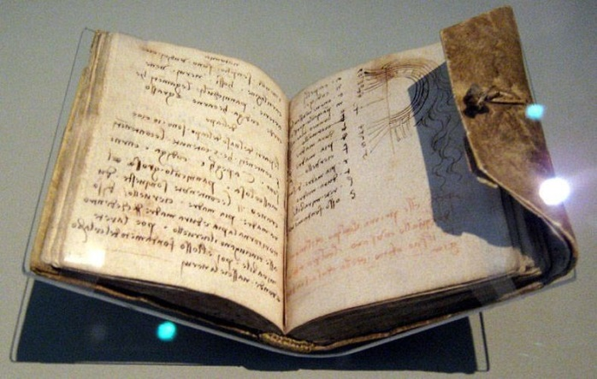
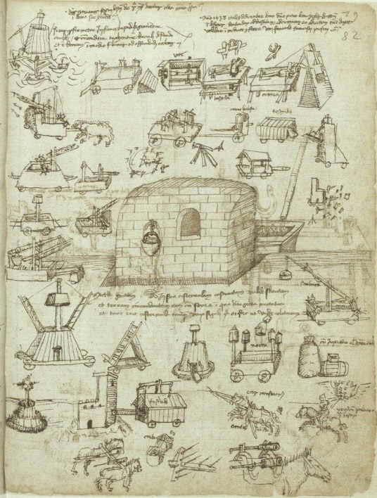
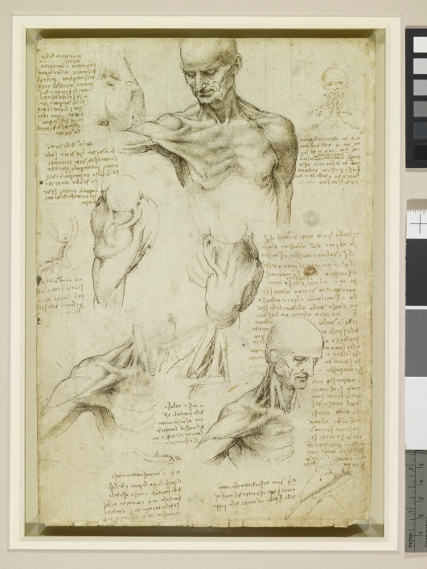
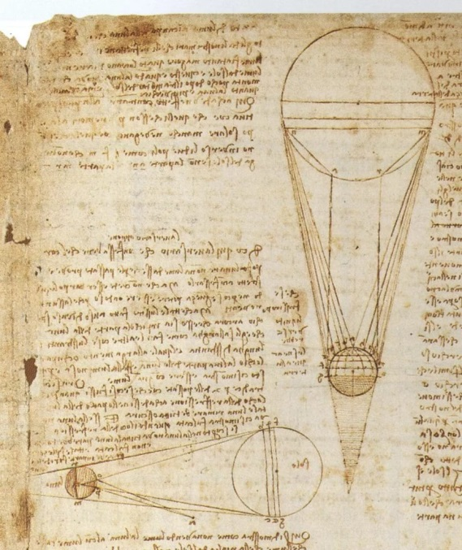
The manuscripts of Leonardo da Vinci

Slide 8
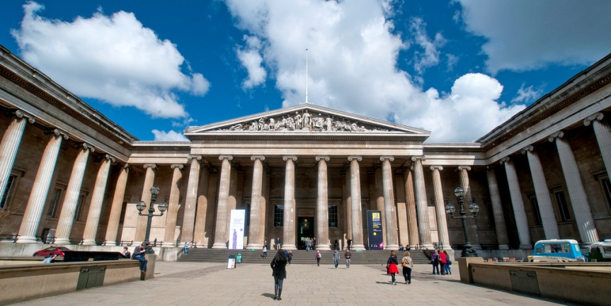
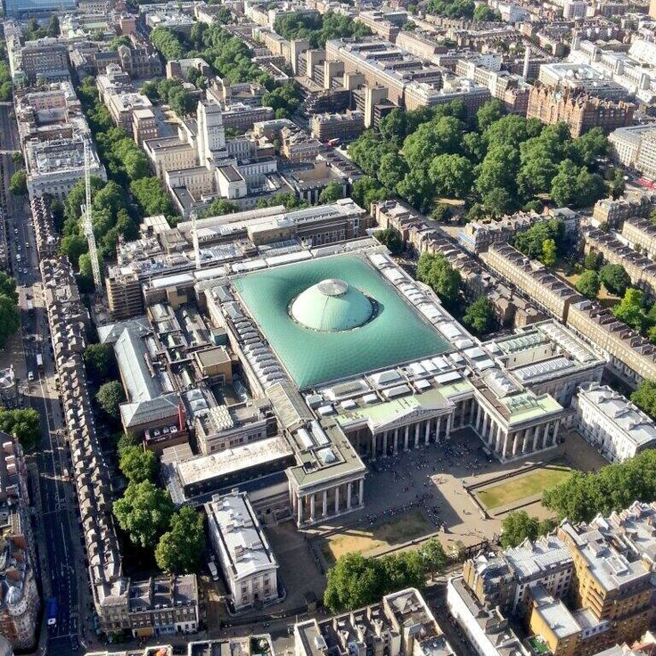
The British Museum is one of the world's largest museums, which has works of art of Ancient Greece, Mesopotamia, Ancient Rome, Ancient Egypt, items of European and Asian masters of the Middle ages, collections of coins and medals, drawings
The British Museum is a real pride of Britain

